Slide 1

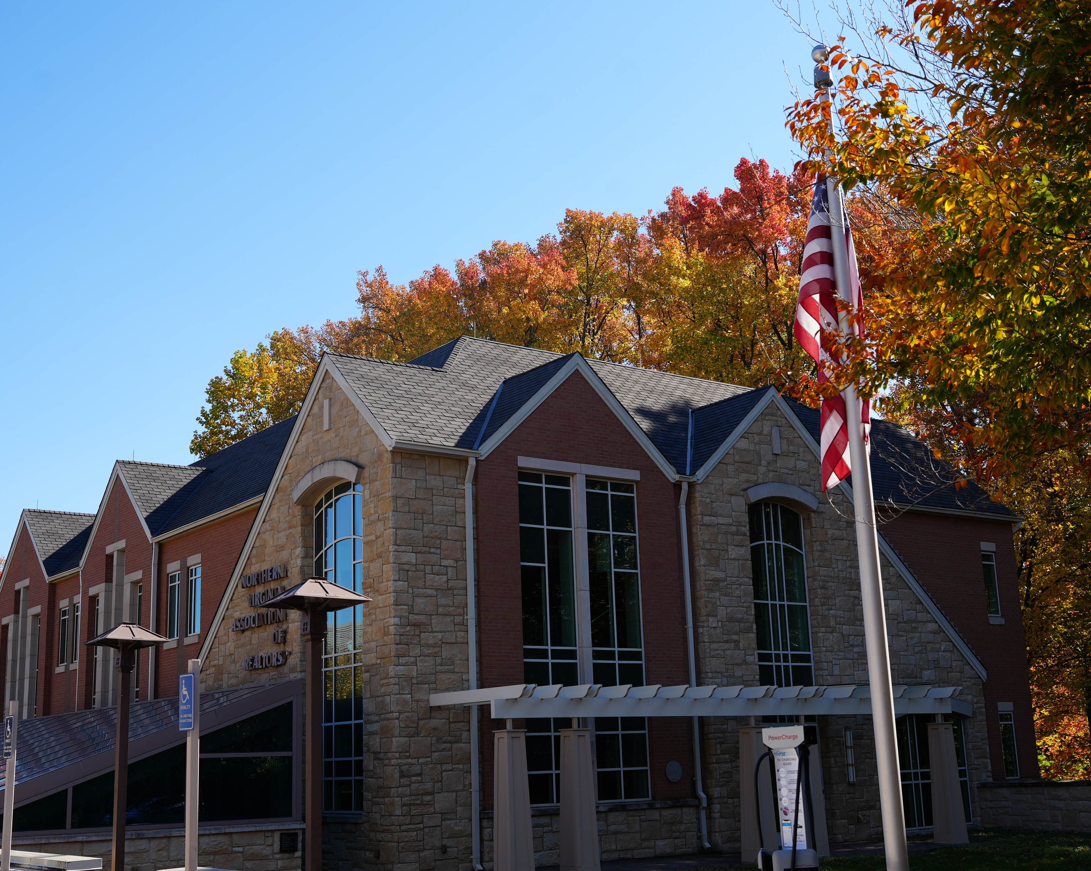
Benefits of Becoming an NVAR Strategic Partner
The Northern Virginia Association of Realtors®
January 2025

Slide 2

Agenda
About the Northern Virginia Association of Realtors®
Strategic Partner Benefits
Your NVAR Community
Strategic Partnership Levels

Slide 3
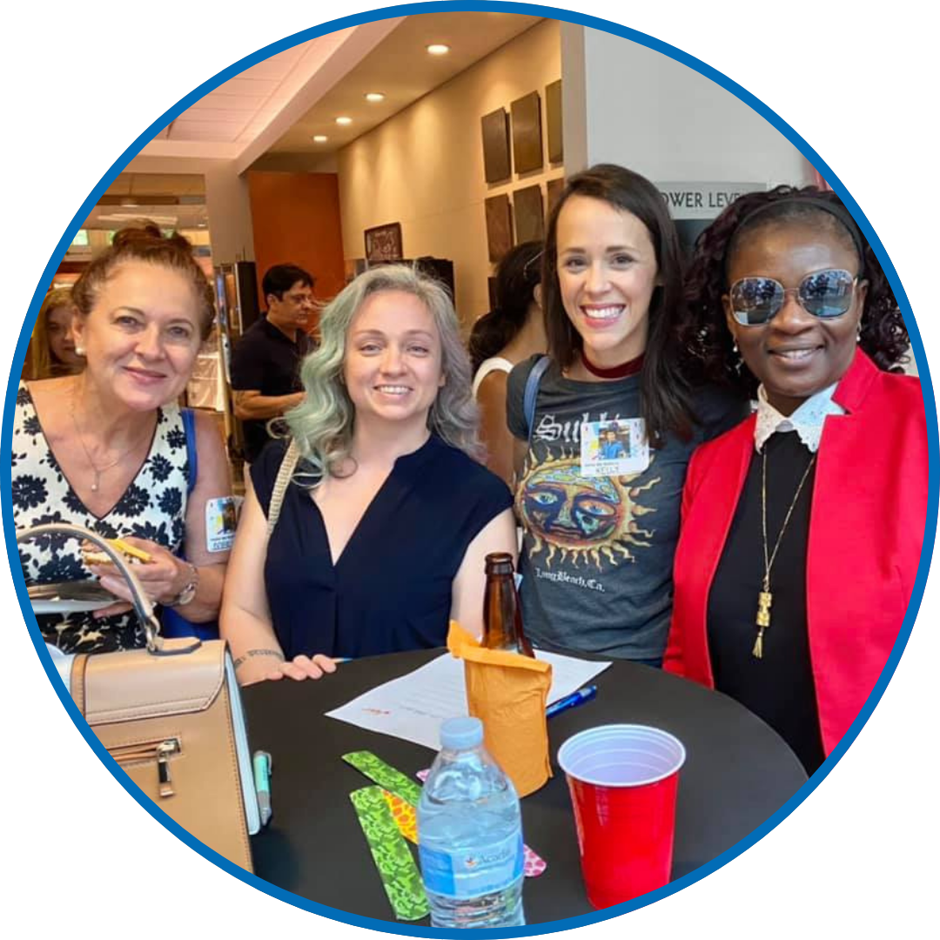
NVAR What We Do & Our Mission
What We Do
NVAR serves as the voice of real estate in the Greater Northern Virginia region. We support our 13,000 members with essential resources, including industry education, advocacy, networking and professional development opportunities.
Mission
Elevating Realtor® success by delivering exceptional value, driving innovation, and impacting the industry.

Slide 4


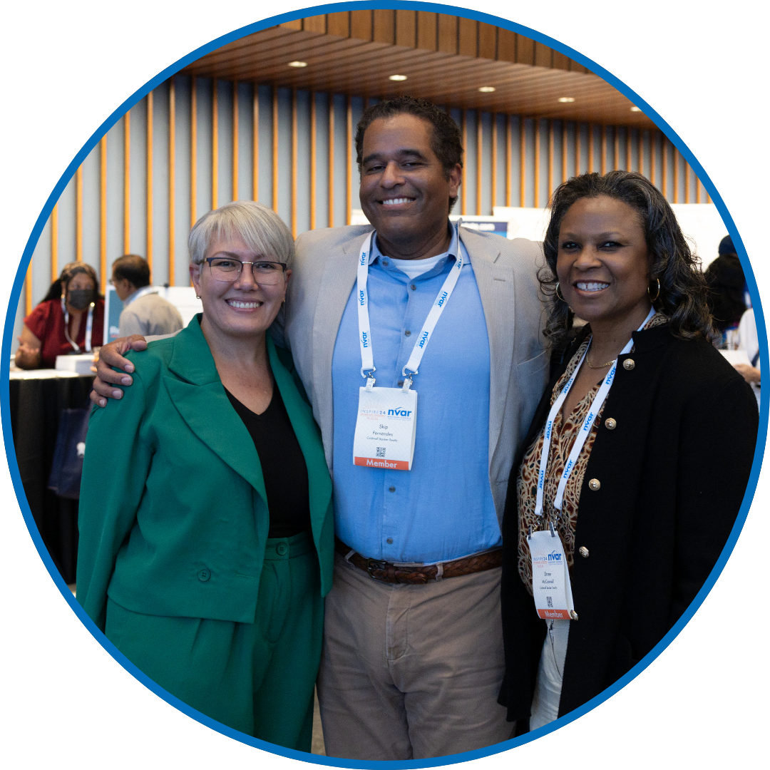
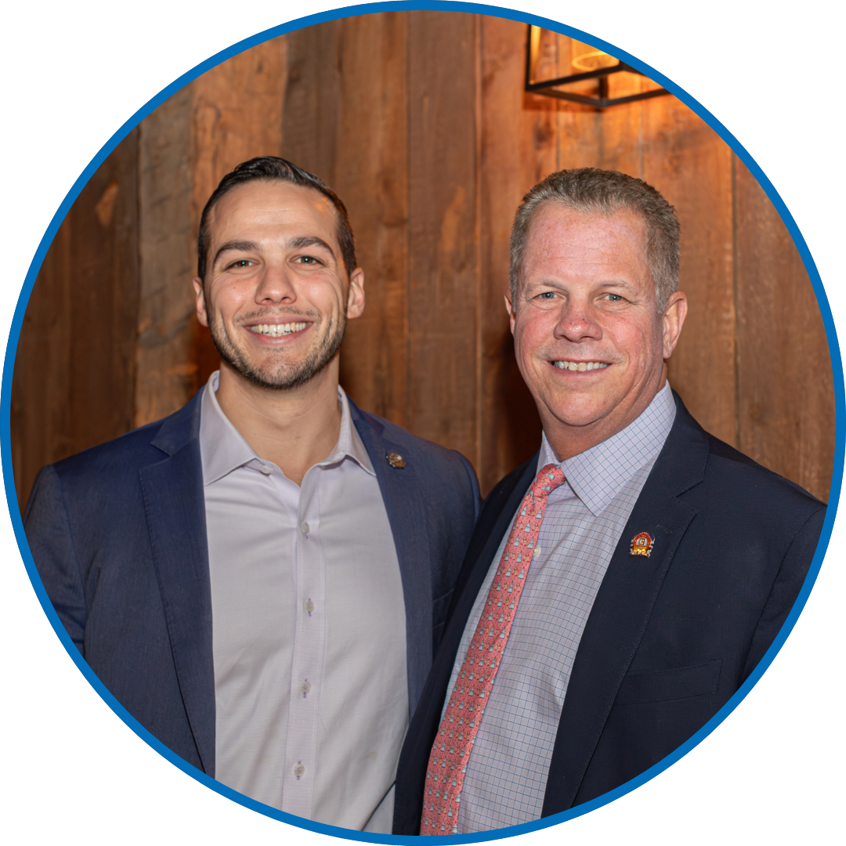
Who is NVAR?
13,000+
Realtors® in
Northern Virginia
$15+ Billion+
Real Estate transactions each year
Top 12
Largest Local Association in the Nation
300+
Service Provider
Members

Slide 5
What Makes NVAR Special?
The voice of real estate in Northern Virginia
Growing global presence – inbound & outbound clients
400+ educational programs and events annually
Ability to volunteer alongside fellow members on forums and committees
Close relationship with Bright MLS and industry leader partners
Advocates for homeownership in Northern Virginia and beyond
Countless member benefits including complimentary Virginia Continuing Education (CE), Post-Licensing (PL), and Broker Continuing Education; Standard Forms Library; Docs+; Digital Experience Center (DXC)

Slide 6
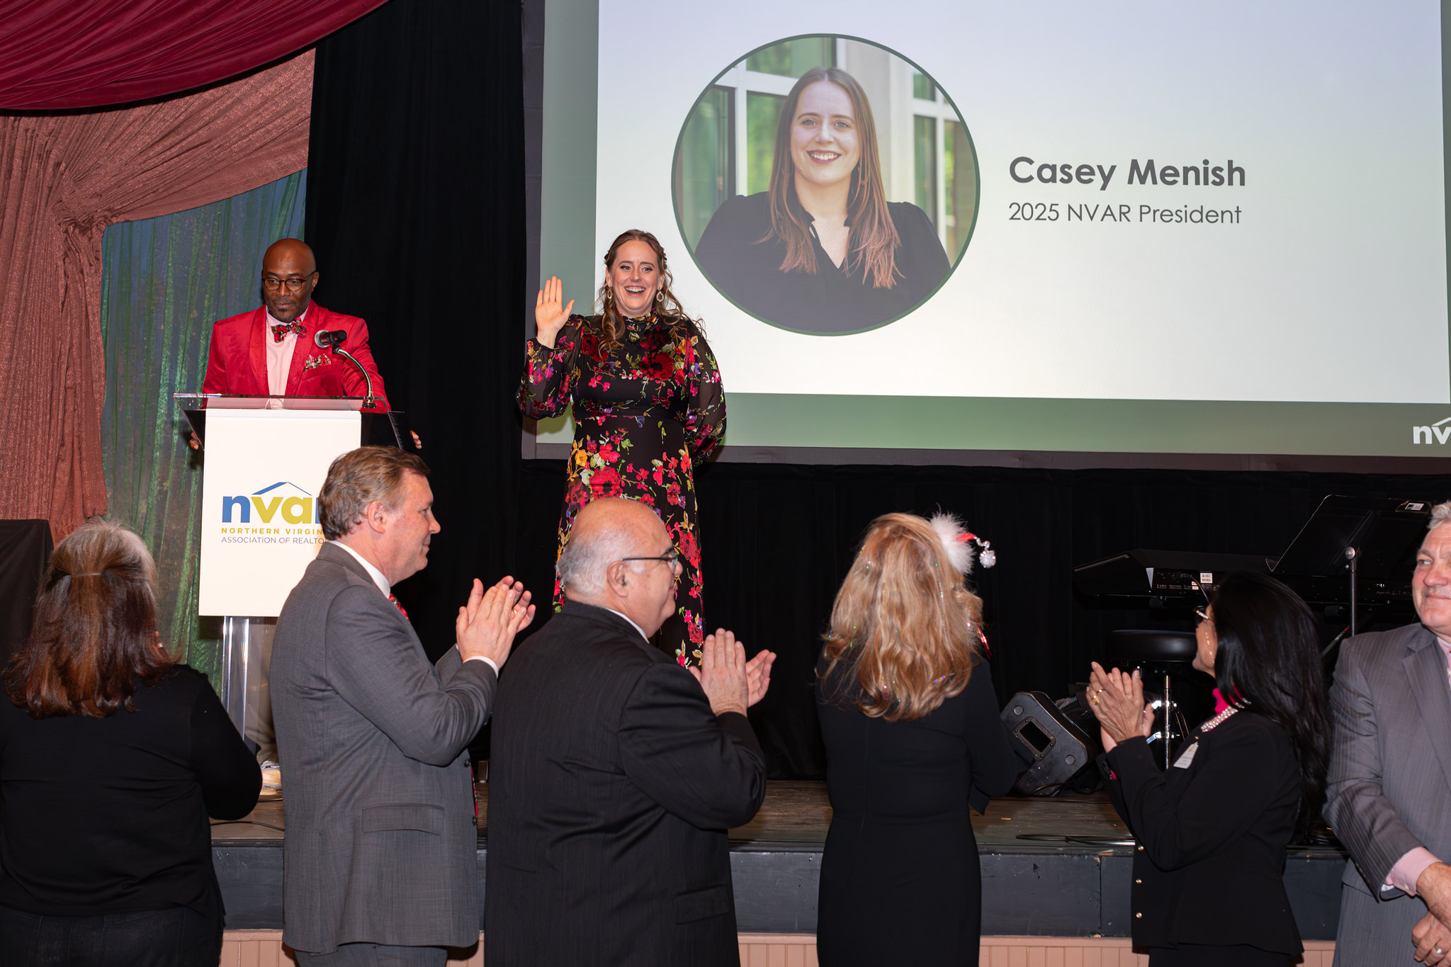
Board of Directors
16 Members
12 elected at-large to 2-year staggered terms
3 appointed by the President to a 1-year term
1 Immediate Past President
6-year term limit; can re-run after 1 year off
Officers
President
President-Elect
Secretary/Treasurer
Immediate Past President

Slide 7

Committees & Advisory Groups

Slide 8


NVAR in the Community

Slide 9
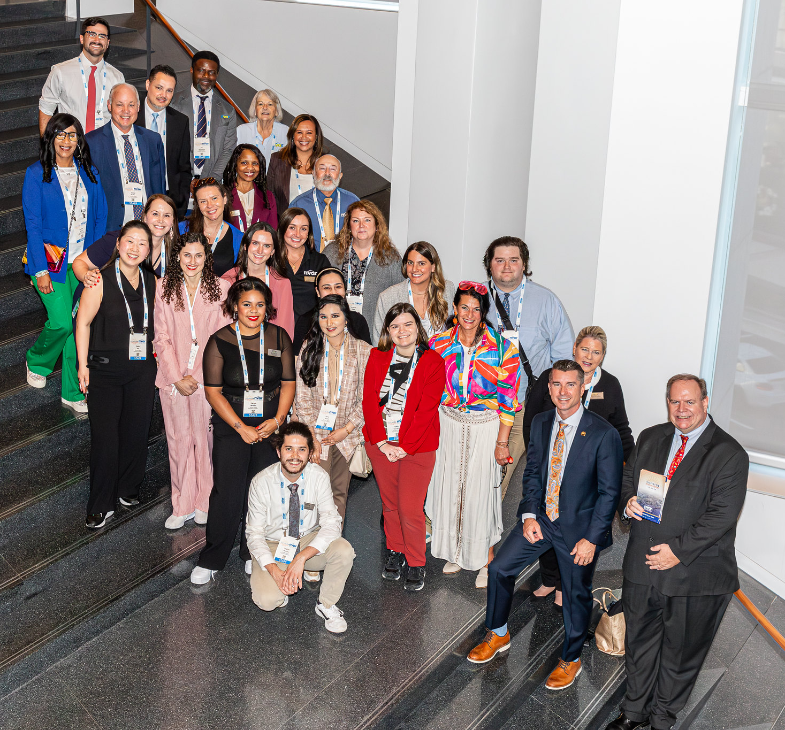
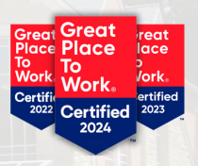
Association Staff – A Winning Team!

Slide 10



Strategic Partner Benefits
Marketing on NVAR Digital Signage
Table at most
NVAR events
Exhibit Booth at the Annual NVAR Convention and Expo

Slide 11
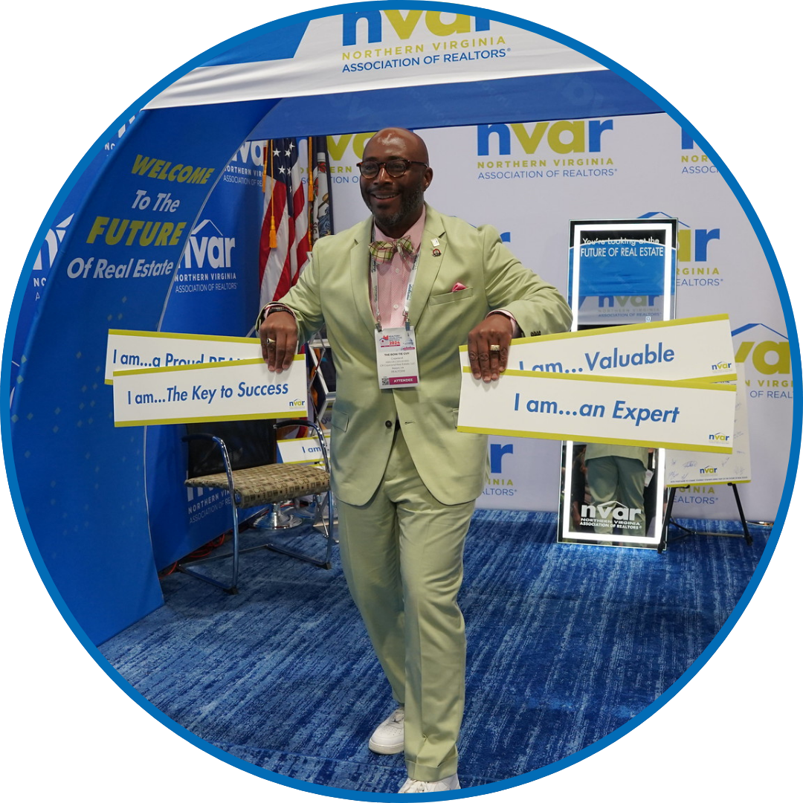
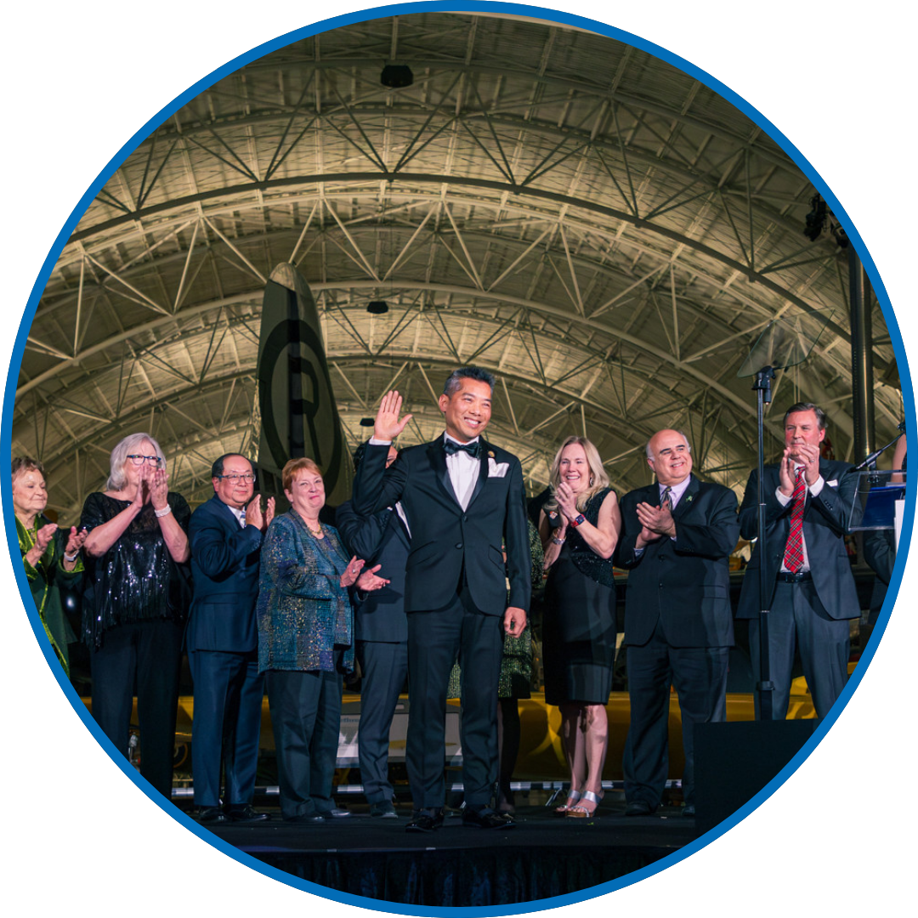

Strategic Partner Benefits
Brand Recognition (including a co-branded webpage on nvar.com)
Affiliation with NVAR
& Inclusion in Shop Realtor®
Access to the Digital Experience Center (DXC) and Room Rentals

Slide 12


Hear from Sherry Skinner
    "Interstate's NVAR Strategic Partnership investment has given us many great opportunities for exposure to the Northern Virginia Realtor® community. Our Tower level partnership has helped me build long-term relationships with our referral partners, which creates both consistent and repeat business opportunities.”
    – Sherry Skinner

Slide 13
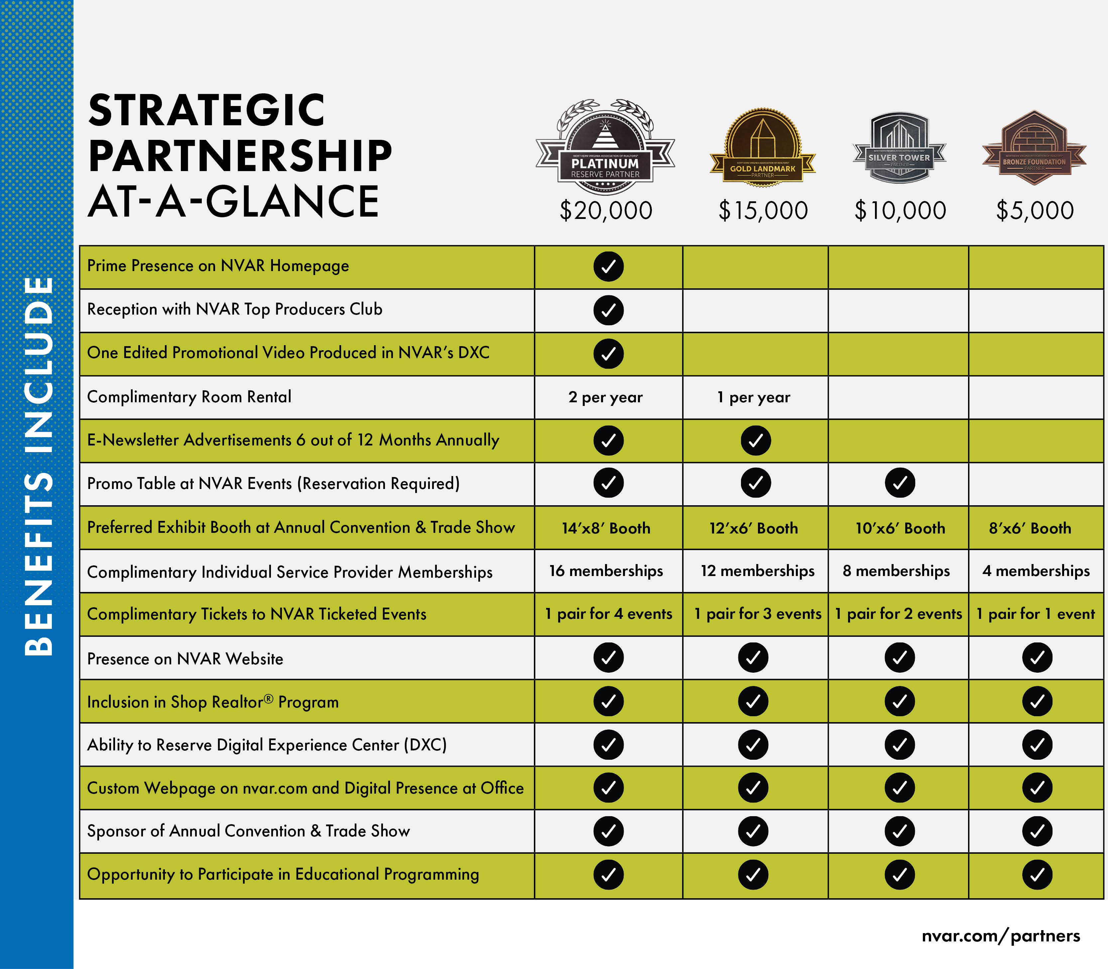
Strategic Partnerships

Slide 14
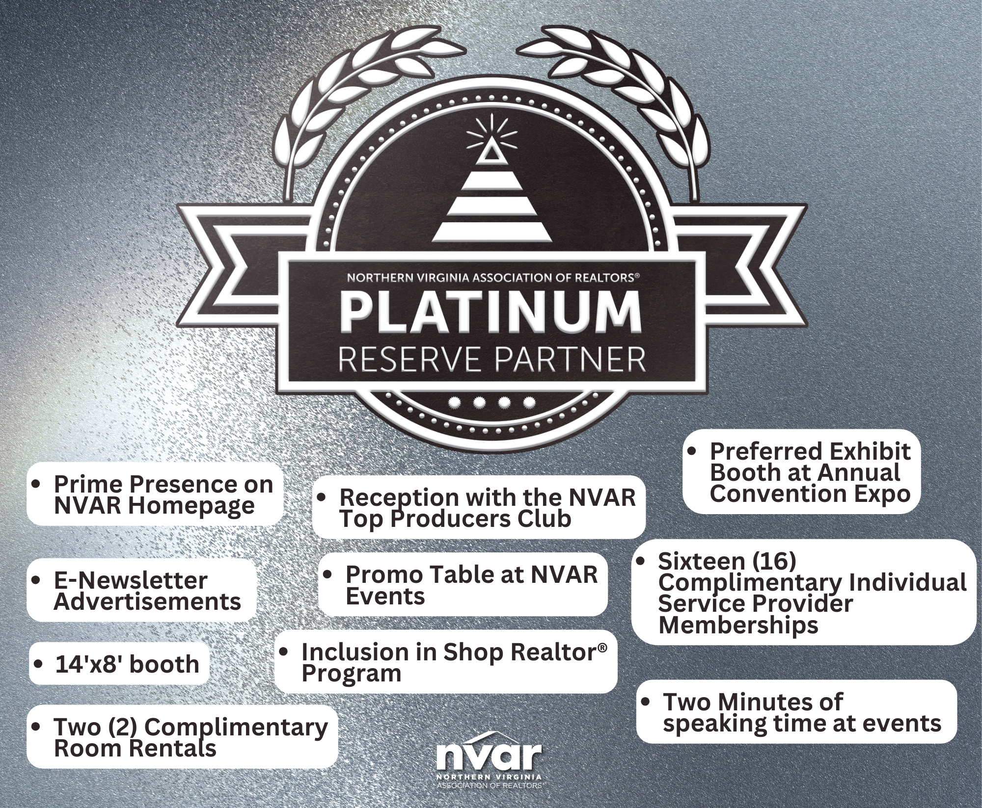
Platinum Reserve Partnership

Slide 15
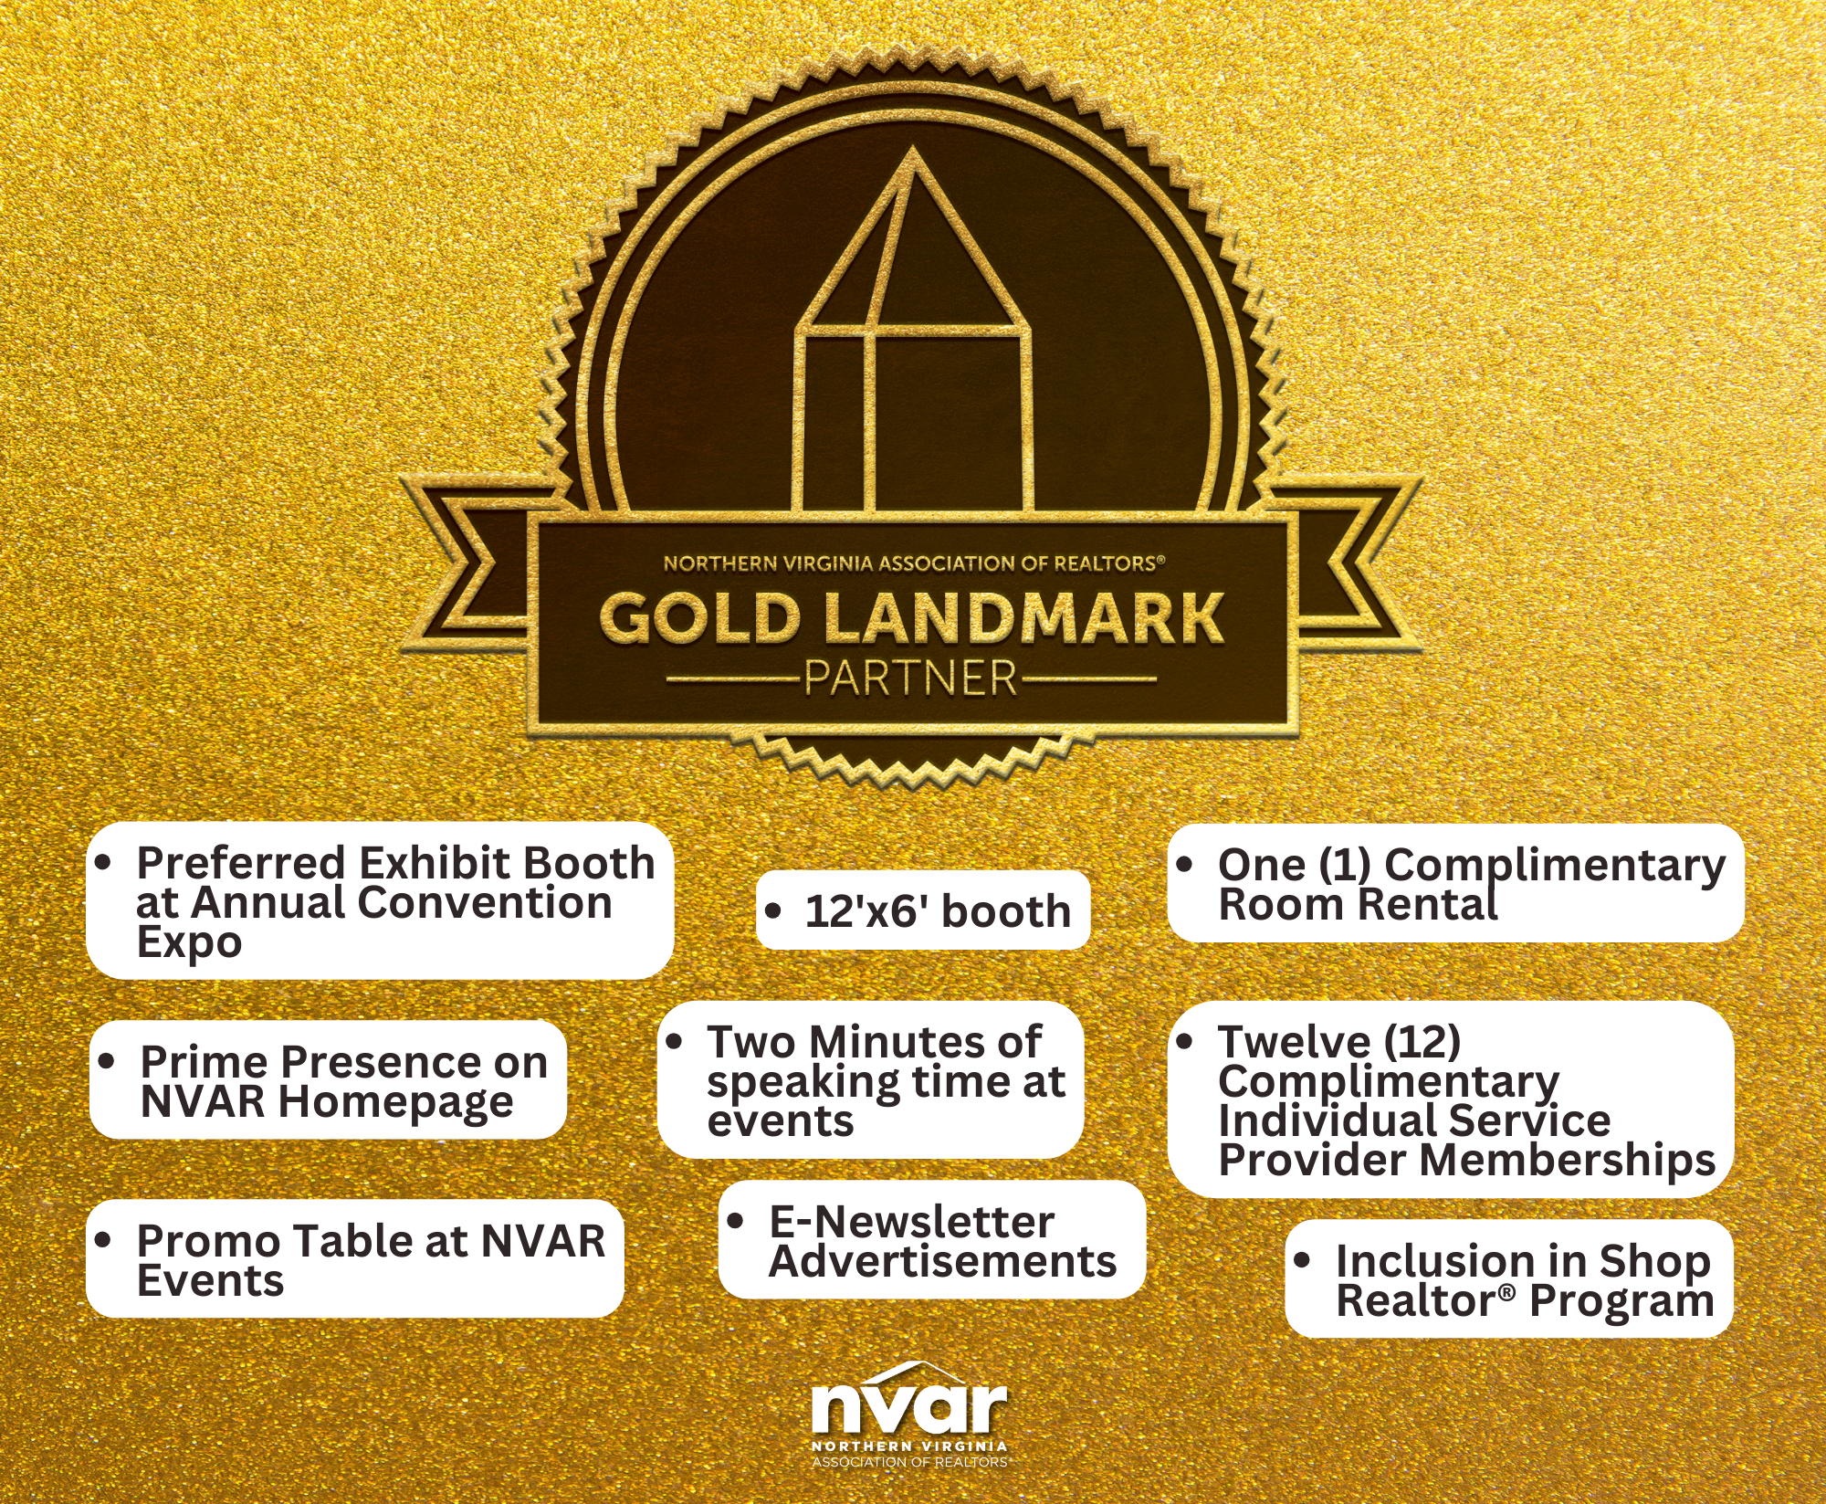
Gold Landmark Partnership

Slide 16
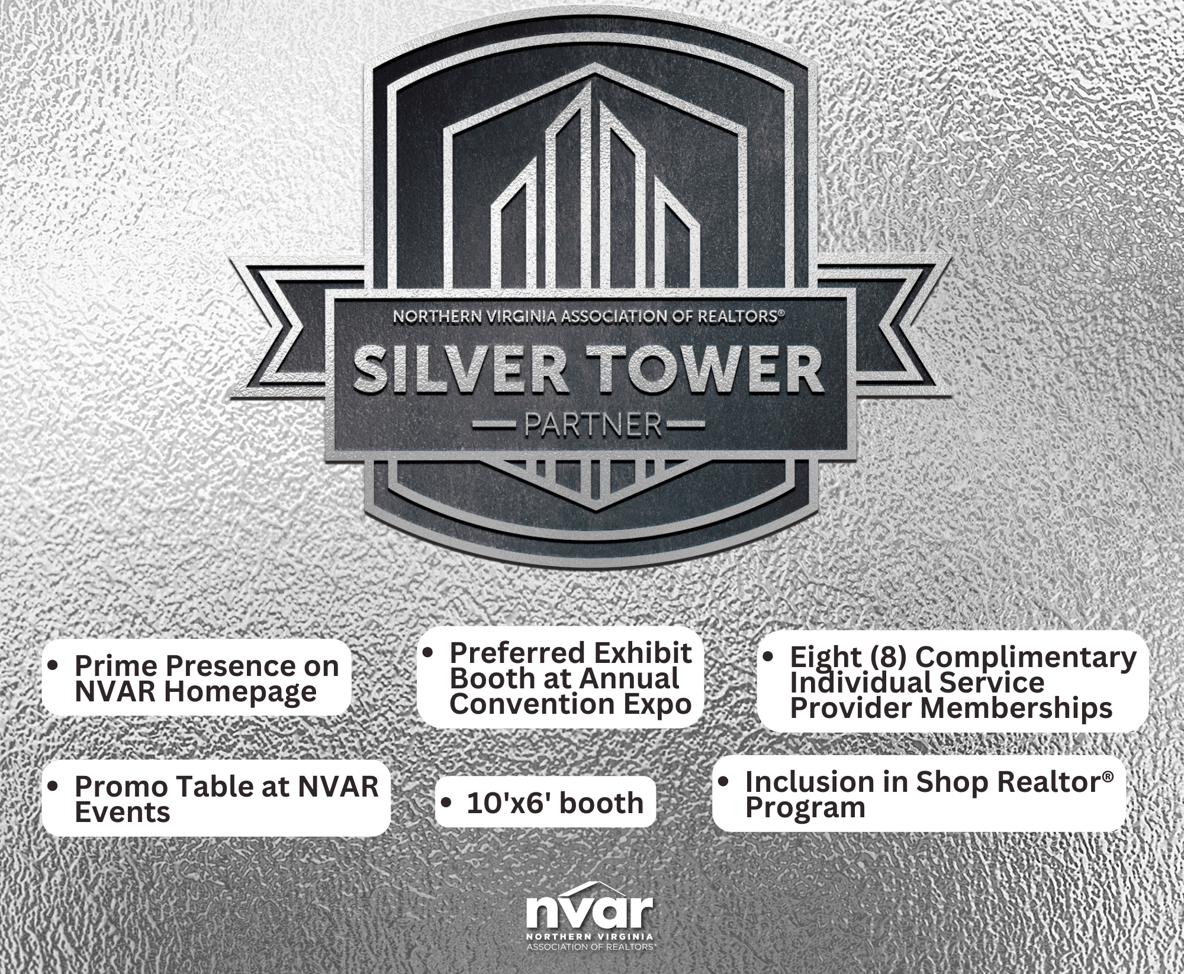
Silver Tower Partnership

Slide 17
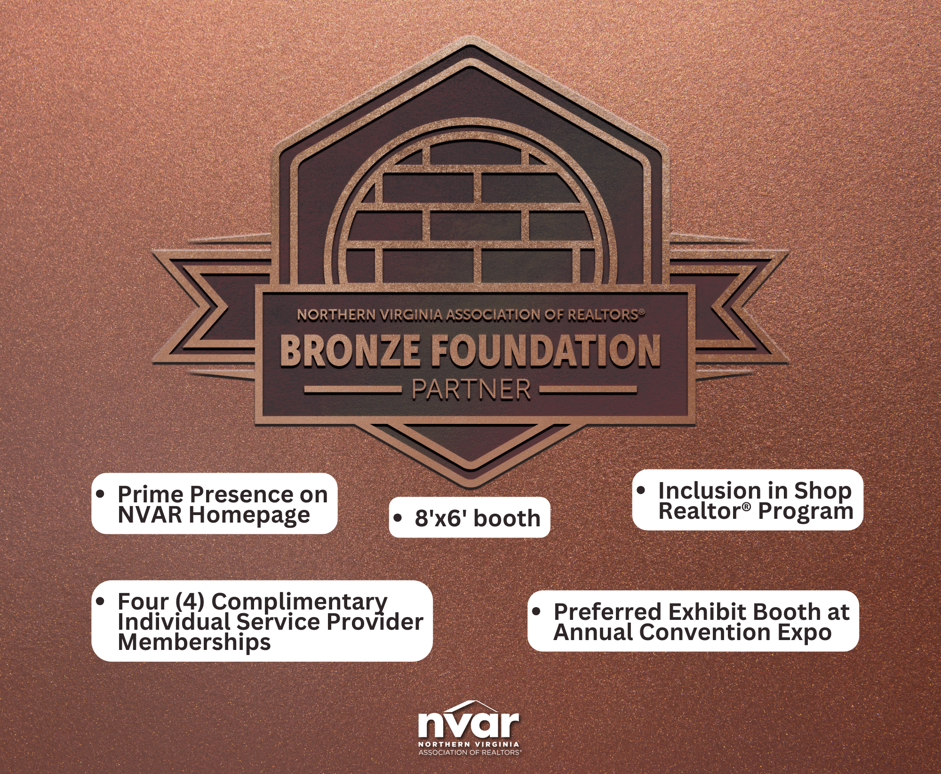
Bronze Foundation Partnership

Slide 18

2025 Strategic Partners

Slide 19

Shirin Abadian
Place
Headshot
Here
Associate Director of Strategic Partnerships
703-207-3235
Shirin@nvar.com

Slide 20


Thank You
www.nvar.com

