Slide 1
Northern Virginia Association of Realtors®

Slide 2
NVAR.com/007

Slide 3
Creating An Online Presence
FIND YOU
LIKE YOU
TRUST YOU

Slide 4
Search Engine Optimization Tips
SEO is your ability to be found in search
All your websites and social media should say you are a real estate agent and Realtor®
Have your brokerage, office address, phone number, and email in all places
Link all your sites together. Update them
Have pictures, bios, and reviews
Name your listing photos with your name-address-feature

Slide 5
Your Online Identity
Google Yourself. What do you find?

Slide 6
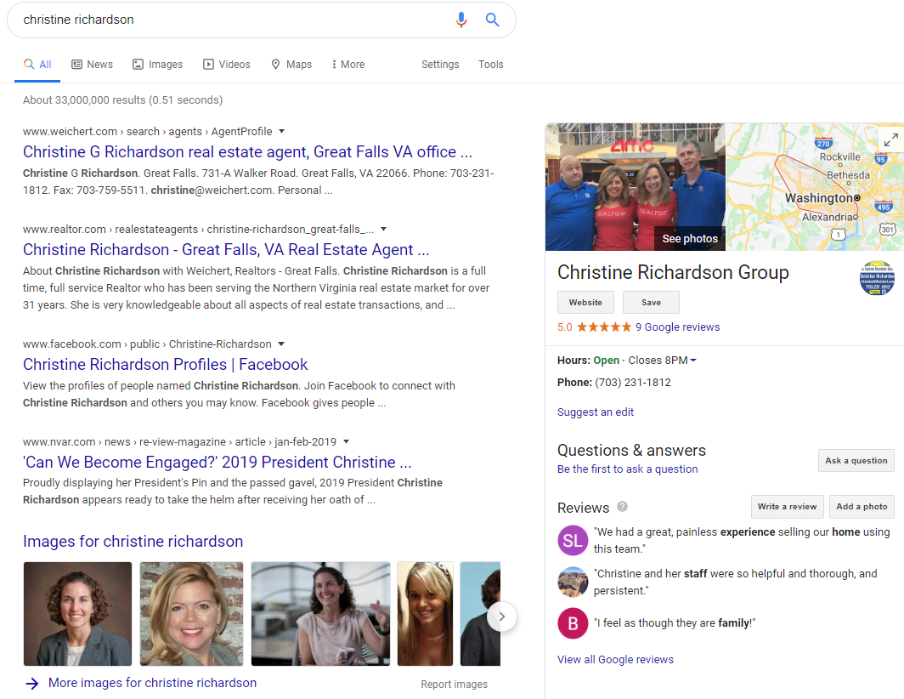
Your Goal
For
Search

Slide 7
Realtor.com Agent Profile

Slide 8
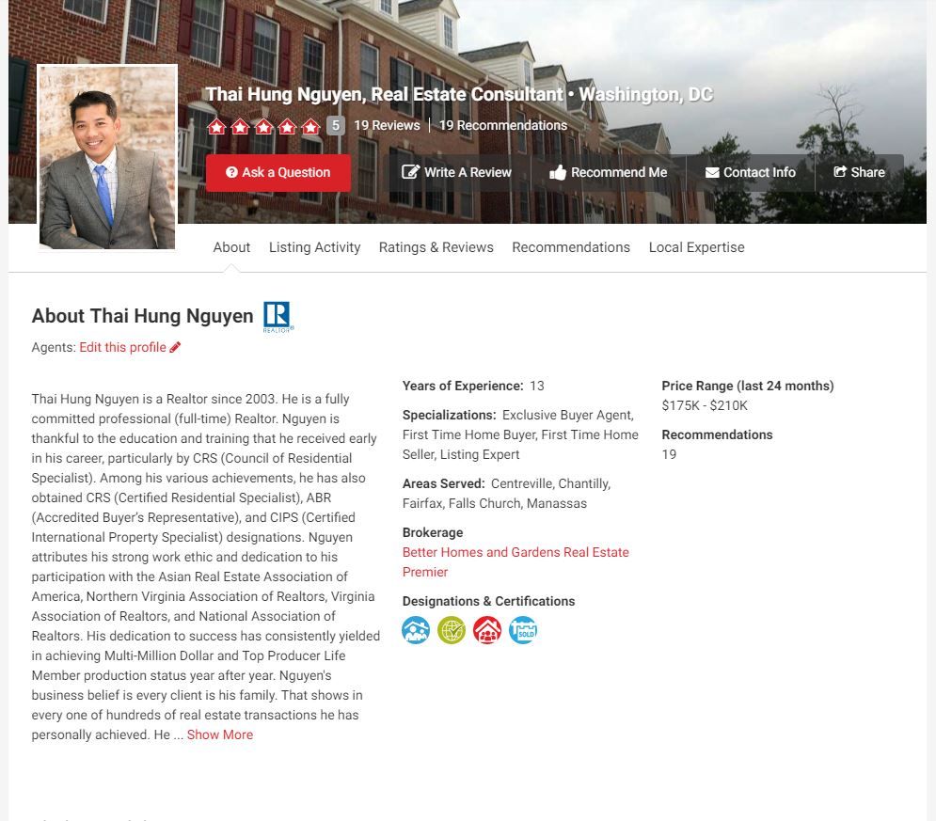
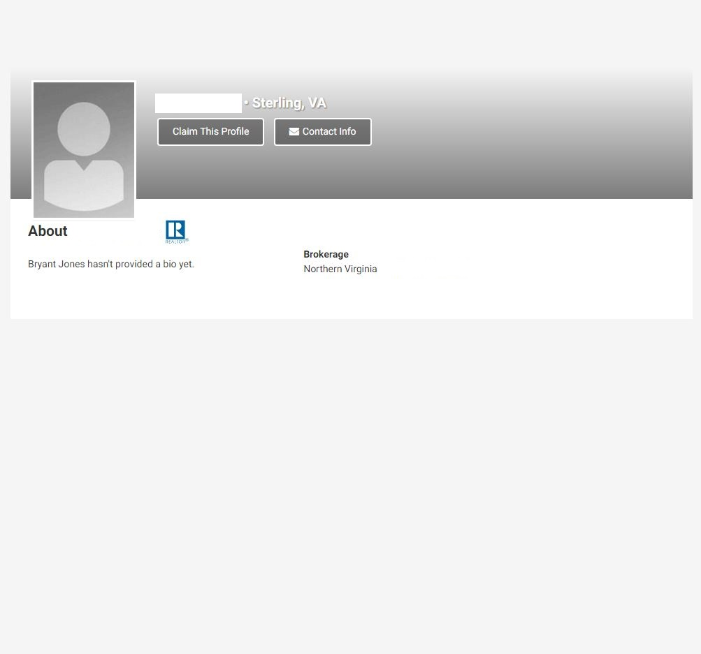
Complete vs Unclaimed Profile

Slide 9
Online Presence Question Exercise
[Name] is a [title] who works with [who you help] to [how you help them]
[Name] [knows/believes] [what you know/believe about the work you do].
[Pronoun] has [learned/created/supported/achieved] [insert experiences and wins].
[Name] is a [trained/certified/licensed/awarded] [insert trainings, awards, honors, etc.]
Who is your target audience?
What do you what them to learn from your bio?
What life events can you include to illustrate these points?
https://hub.realtor.com/resource/4-easy-steps-perfect-real-estate-agent-bio

Slide 10
Your Realtor.com® Profile
Agent Profiles present opportunity
70% of profile views come from organic Google Searches
30-35% of NVAR members have claimed their profiles
The national average of claimed profiles 25-30%
NVAR has integrated your profile into its member directory

Slide 11
Fill Out Your Profile
AT A MINIMUM:
Claim your profile
Put in your headshot and a background photo
Fill in your “About Me” section
Put in office address, phone number, your website, and social media

Slide 12
Personal Domain Options
.REALTOR domain name (i.e. RickySellsHomes.REALTOR)
Visit this site to claim your domain today: https://www.get.realtor/
Realtors get their first custom domain and email address FREE for a year
Placester
NAR Members receive a 20% discount on two different subscription packages

Slide 13
Online Reviews
62%
of home buyers choose a Realtor based on online reviews and real estate agent ratings.
-Zip Realty
What are the top 3 review sites for real estate agents?

Slide 14
Most-Used Review Sites For Agents

Slide 15
10 Minute Break

Slide 16
Your Website & Social Media
Facebook, Twitter, and Linkedin are great ways to build your online presence
Be sure your public presence portrays the image you want
Facebook Business Pages allow you to have unlimited Likes
Content in Business Pages are searchable in Google

Slide 17
Content: NAR Realtors® Content Resource
Realtor® Content Resource

Slide 18
The Realtor® Difference
VIDEO: Highlighting the Realtor(r) Brand

Slide 19
Realtor Magazine Online
Magazine.realtor

Slide 20
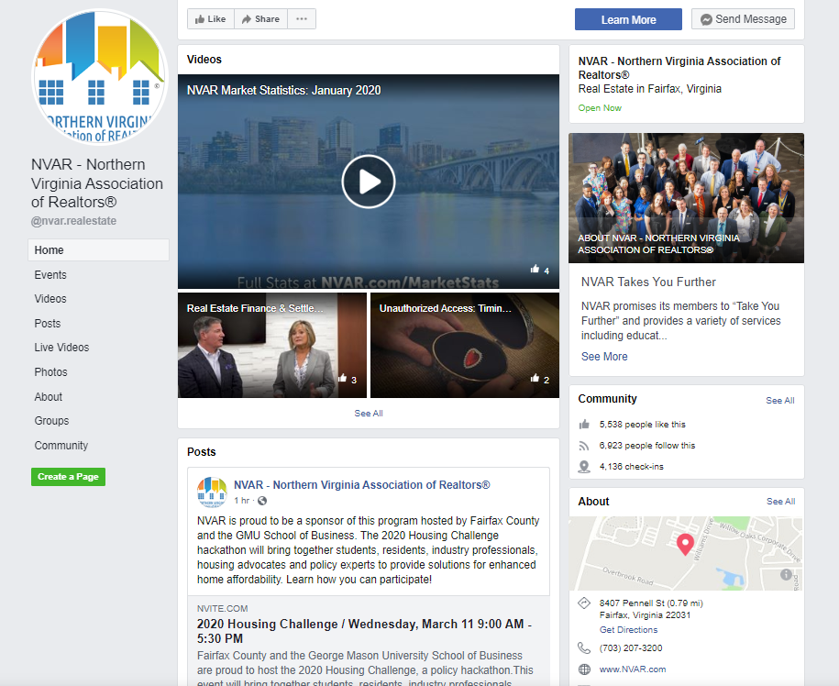
NVAR’s Facebook Page
https://www.facebook.com/nvar.realestate/

Slide 21
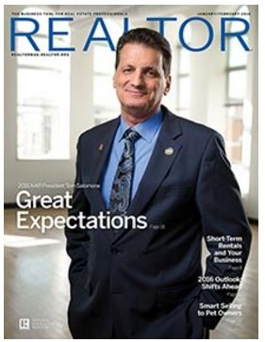
Publications

Slide 22
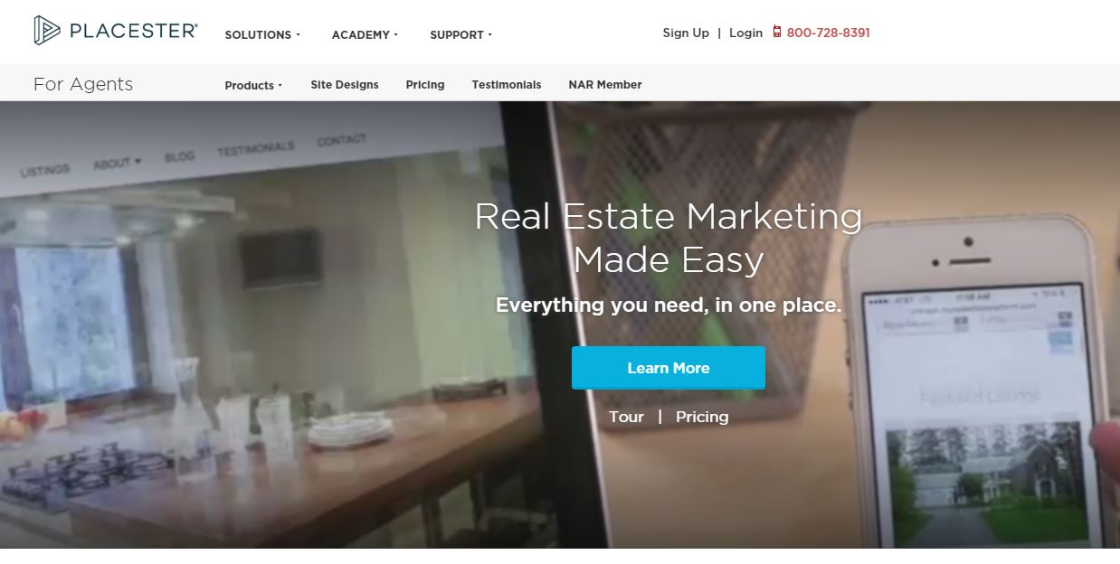
Other News Resources

Slide 23
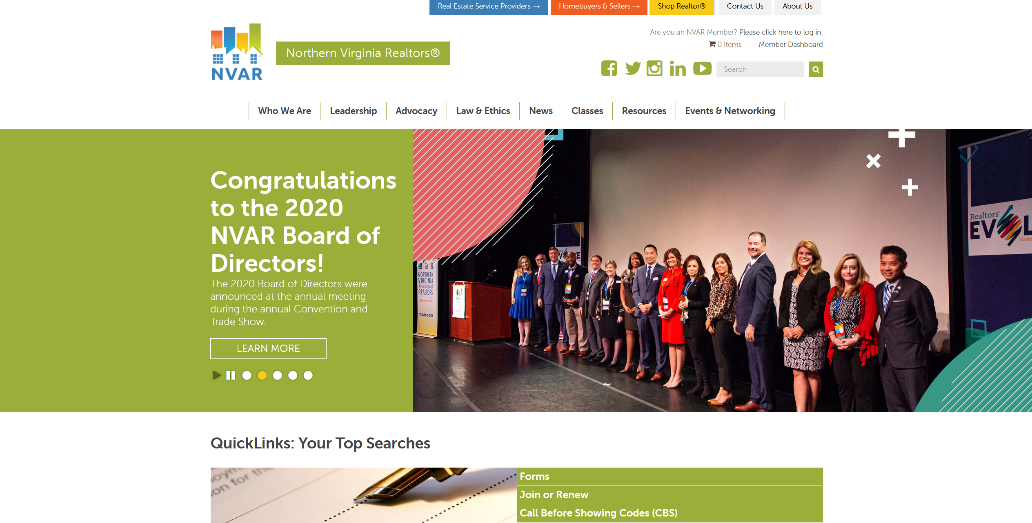
NVAR website: www.nvar.com

Slide 25
Shop Realtor
NVAR has reframed its products, services and service providers into 8 core competencies based on how Realtors do business
Client Driven Solutions
Business Driven Solutions
Every aspect of the NVAR website reflects this organization of resources for your business

Slide 28
SentriLock & the SentriSmart™ App
Now Integrated with RPR!

Slide 30
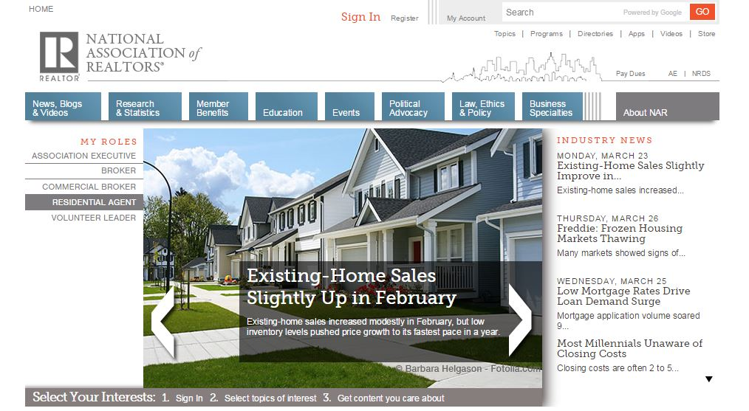
NAR.realtor

Slide 31
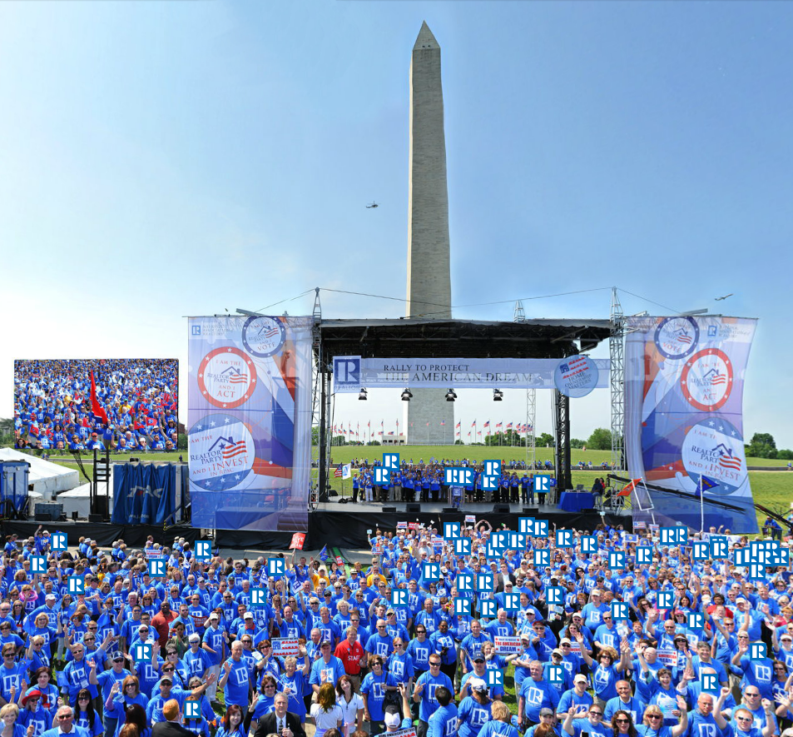
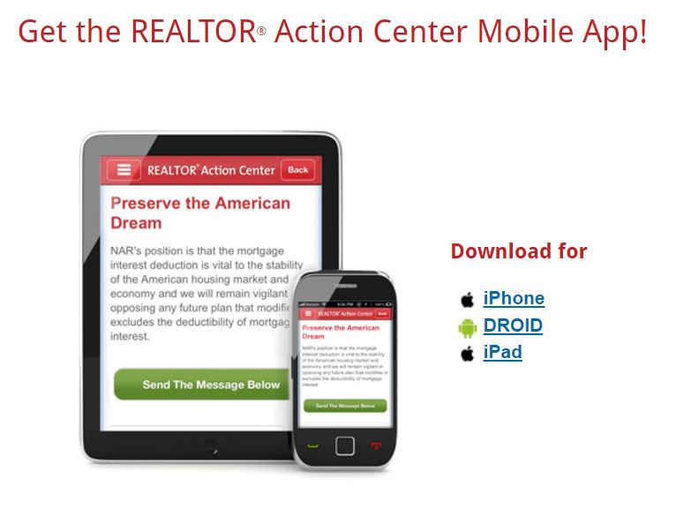

Slide 32
Realtors Property Resource® (RPR)

Slide 33
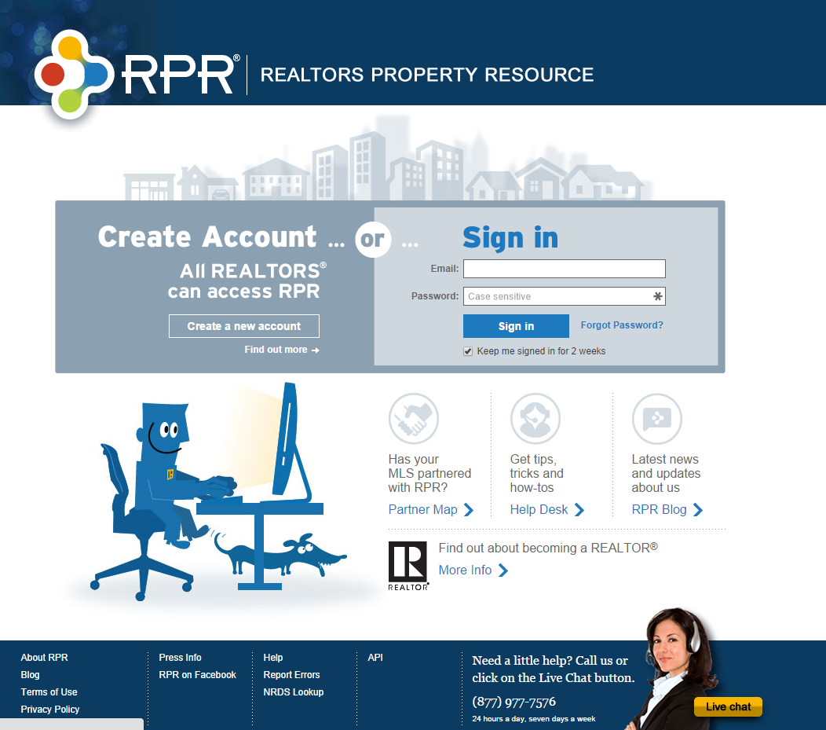
Realtors Property Resource® (RPR)
www.narrpr.com

Slide 34
Homesnap

Slide 35
Realtor Safety
http://www.realtor.org/safety
(check out “Resources for REALTORS®)

Slide 36
Bright

Slide 37
Tech Support available:
M-F, 9am-8pm
Sat 9am-5pm
800-276-4216
NVAR.com/TechHelp

Slide 38
NVAR Service Providers
Build a service provider network for your clients

Slide 39
NVARConvention.com – Every October

Slide 42
Don’t Be A Secret Agent!

