Slide 1
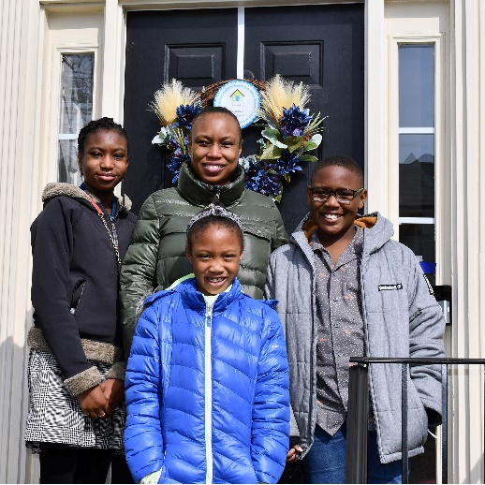
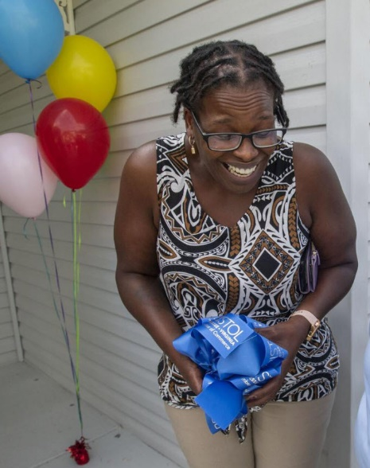
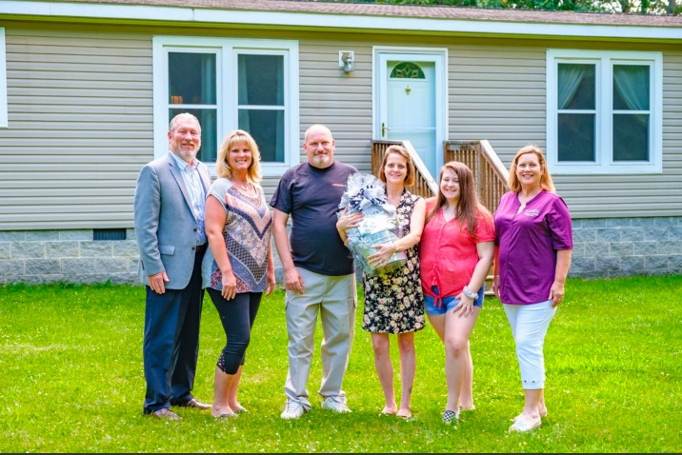
Virginia Housing…
Was created in 1972 to provide quality, affordable housing to the citizens of Virginia
Receives no federal or state funding and is an Authority of the Commonwealth of Virginia
Sells taxable & tax-exempt mortgage bonds & is an approved seller to Ginnie Mae, Fannie Mae, & Freddie Mac

Slide 2
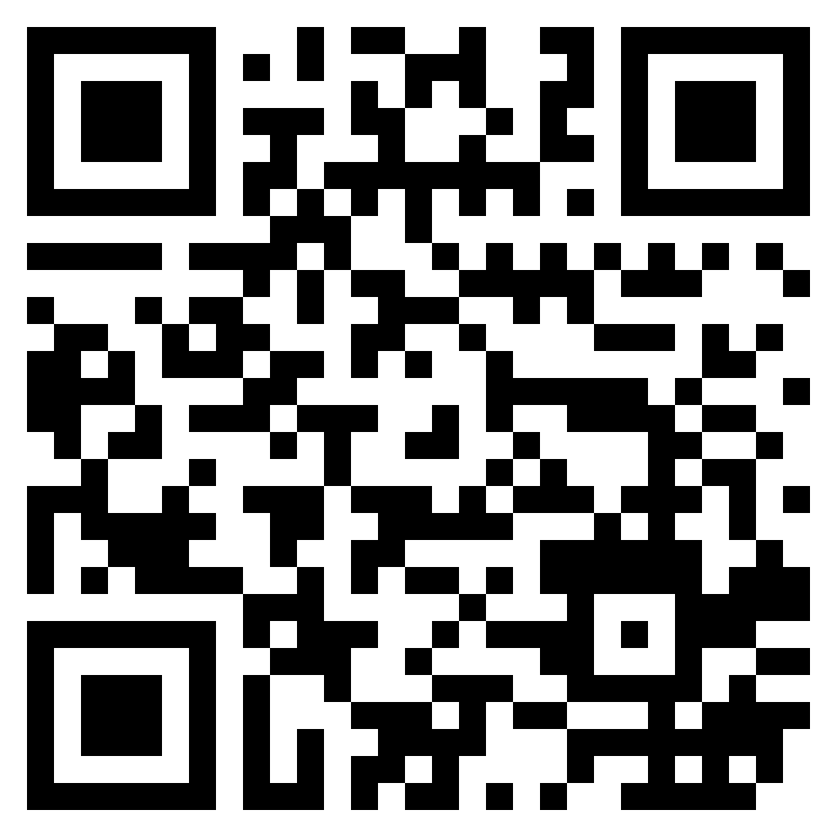
Find Affordable Rentals with the Virginia Housing
Search
https://www.virginiahousingsearch.com

Slide 3
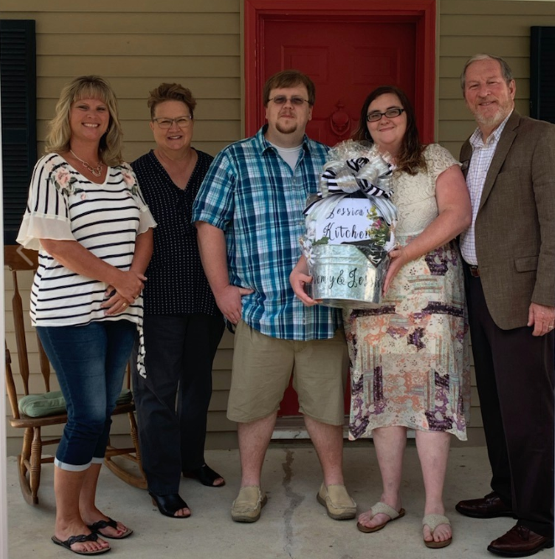
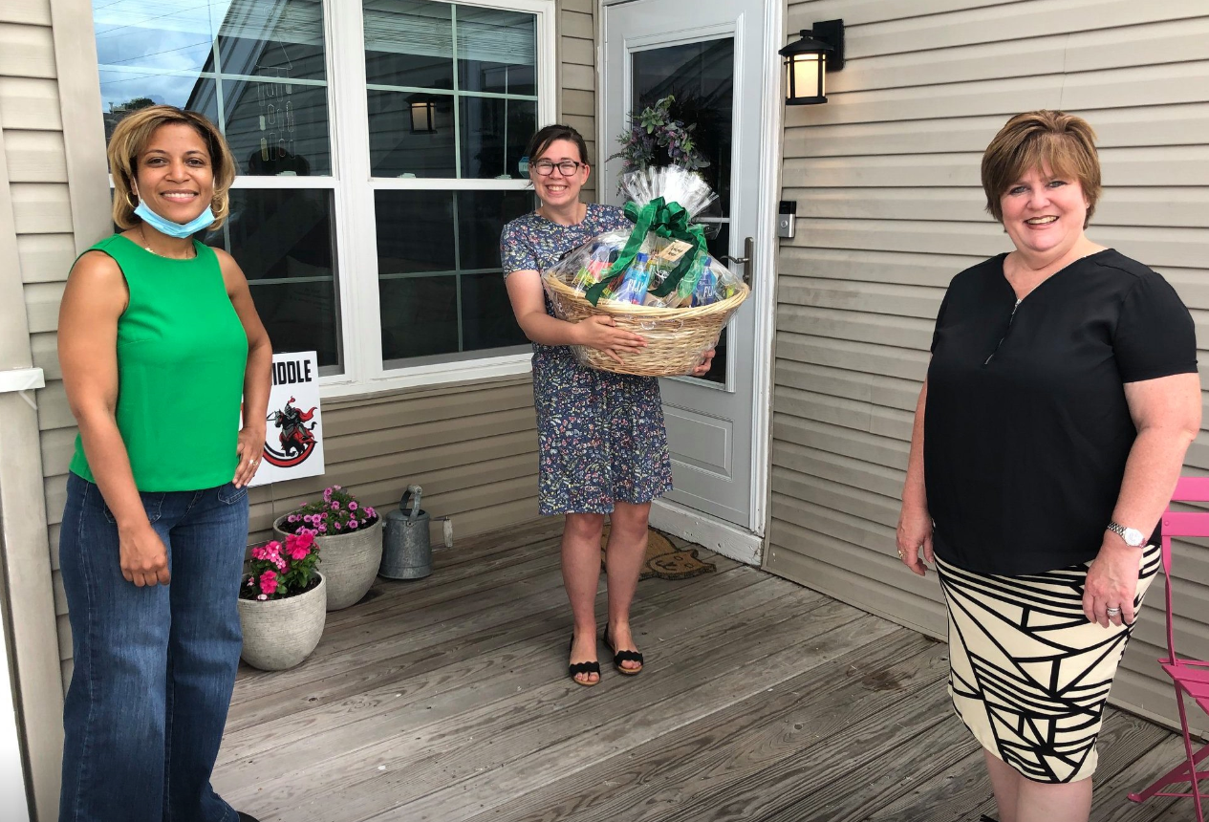

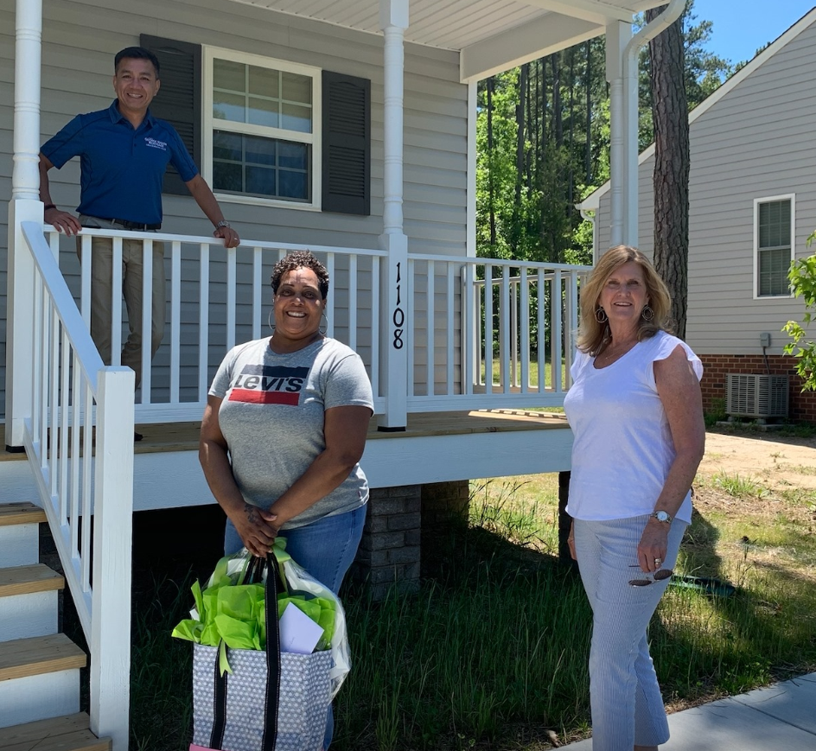
What We Do
HOMEOWNERSHIP DIVISION…
Provides and services mortgages, primarily for first-time homebuyers
Promotes the use of our programs through joint sales and training activities with lenders, real estate agents, and housing industry partners
Offers direct originations to the public in rural areas where traditional lending options are scarce

Slide 4

Being “Mortgage Ready” looks different for everyone.
Income
Income
Credit
Assets
Income
Credit
Assets
Credit
Assets

Slide 5


First-time Homebuyer Requirement
All borrowers must be first-time homebuyers
Definition: An individual who hasn’t had an ownership interest in their primary residence within the last three years.

Slide 6
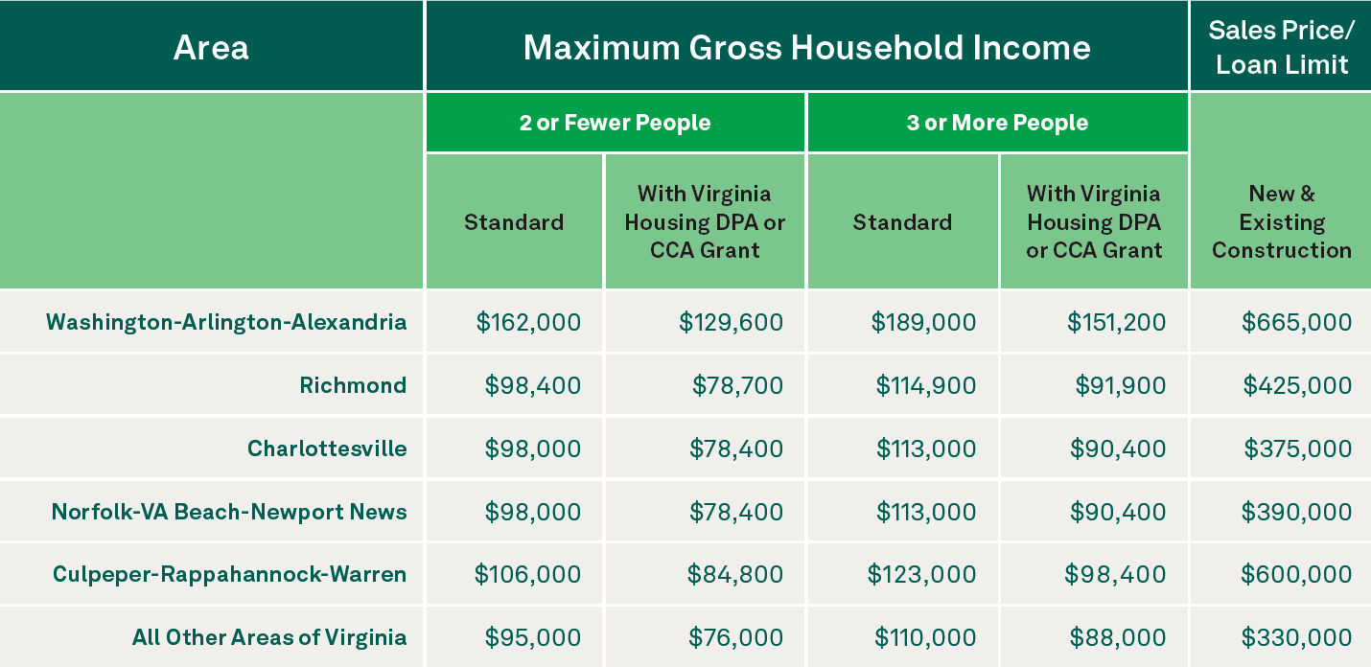

Slide 7





Mortgage Program Options
Borrower gets the loan program of their choice:

Slide 8
Virginia Housing Specialty Programs
Downpayment Grant - Forgiven at settlement
Closing Cost Grant - Forgiven at settlement
Plus 2nd Mortgage - 30-year fixed rate loan
Sponsoring Partnerships and Revitalizing Communities

Slide 9

Virginia Housing
Lending Wizard
https://lendingwizard.vhda.com/

Slide 10

Comparison
Arlington, VA
Conventional
Sales Price: $500,000
Seller Contributions: $0
Credit Score: 660
Income: $105,000
Household Size: 3
Notes:
*BULLETS OF CONSTANTS FOR THE COMPARISON FADE IN ONE AT A TIME ON THEIR OWN – NO NEED TO CLICK
Here is a comparison of someone obtaining 97% Conventional financing with no assistance, then comparing it to when Virginia Housing’s program is used with the DPA Grant, and last but not least – using not only Virginia Housing’s financing and DPA Grant but pairing it with other assistance that’s readily available.
So the unchanging items are:
-This is Conventional financing as mentioned,
-$235,000 sales price in Hampton Roads – Chesapeake area,
-There are NO seller contributions, which is the norm in this market and probably the foreseeable future,
-Credit score of 690
-Annual income (both qualifying and household for this purpose) of $67,000, and
-Household of 3.
Also note that the interest rates for each of these examples were true market rates and Virginia Housing’s true rate on the same day very recently.
*If anyone asks: Our 2021 income limit for the DPA Grant in this region for household of 3 is $84,300. Our 2021 sales price limit for this region is $390,000.

Slide 11
Comparison
Arlington, VA
Conventional
With…
no assistance
3% downpayment
Details of Purchase
Purchase Price | $500,000
Closing Costs / Prepaids | $15,707
First Mortgage @ 97% | $485,000
Funds Required at Closing | $30,707
Total Housing Payment
P & I @ 7.625% | $3,433.00
Taxes & Insurance | $528.00
MI at 35% | $400.00
Condo Fee | $500.00
Total | $4,861.00
Notes:
41.4 front Ratio

Slide 12
Comparison
Arlington, VA
with…
Virginia Housing 1st Mortgage
Arlington DPA
No Points
Details of Purchase
Purchase Price | $500,000
Closing Costs / Prepaids | $15,707
First Mortgage @ 80% | $400,000
Arlington MIPAP Silent 2nd | $112,500
Funds Required at Closing | $5,000
Savings | $25,707
Total Housing Payment
P & I @ 7.375 | $2,763.00
Taxes / Insurance/ | $528.00
MI @ | $0
Condo Fee | $500.00
Total | $3,791
Savings | $1070.00
Yearly Savings | $12,843.00
Notes:
31% front ratio
And here is the last scenario where lots of assistance is used together to give this homebuyer the best. Not only is it a Virginia Housing Conventional, there is also our DPA Grant, an FHLB Grant, and assistance from a locality such as some you heard from earlier.
More often than not these programs called “grants” are not true grants in that they are recorded but often do not have a payment and are forgiven over a period of time. They can also be termed Community Seconds (Fannie Mae) or Affordable Seconds (Freddie Mac).
And to top it off, this homebuyer has a 1% reduction in their interest rate due to Virginia Housing’s SPARC.
Most locality grants have a minimum amount the borrower has to bring to closing. It varies but can be anywhere from $500, $1,000, to 1% - which is typically the highest we’ve seen. In this example we used 1% - the highest, and you can see there is still a huge amount of savings., etc.
Look at the savings in the total housing payment with the 1% rate reduction plus lowering of the Mortgage Insurance payment with the reduction in loan amount. This saves the homebuyer almost $300 per month and over $3,500 annually.
And this payment is even more affordable with a very low housing ratio of 26%, leaving plenty of room for things like childcare and other debt such as student loans – over $1,000 could be paid towards other debt and the homebuyer would still be within Virginia Housing’s maximum 45% DTI.
*CLICK DETAILS OF PURCHASE TABLE: puts extra box around $16,692
*CLICK TOTAL HOUSING PAYMENT TABLE: puts extra box around $298
*CLICK TOTAL HOUSING PAYMENT TABLE 2ND TIME: puts extra box around $3,582
*If asked: An income of $67k is within FHLB’s 2022 income limit for a household of 3 in Chesapeake.
*CLTV is well within the 105% max at under 101.5%.
*If a homebuyer wanted to take advantage of Virginia Housing’s Plus Second Mortgage this may not reduce the funds required at closing if the locality has a minimum, however it will save in their monthly payment because the first mortgage could potentially be lowered more with the extra funds offered through the Plus Second (reducing the first mortgage P & I more than adding the Plus Second Mortgage P & I), only adding to their annual savings.

Slide 13
Comparison
Arlington, VA
with…
Virginia Housing 1st Mortgage
Virginia Housing SPARC
Arlington DPA
No Points
Details of Purchase
Purchase Price | $500,000
Closing Costs / Prepaids | $15,707
First Mortgage @ 80% | $400,000
Arlington MIPAP Silent 2nd | $112,500
Funds Required at Closing | $5,000
Savings | $25,707
Total Housing Payment
P & I @ 6.375 | $2,496.00
Taxes / Insurance/ | $528.00
MI @ | $0
Condo Fee | $500.00
Total | $3,524.00
Savings | $1,337.00
Yearly Savings | $16,050.00
Notes:
31% front ratio
And here is the last scenario where lots of assistance is used together to give this homebuyer the best. Not only is it a Virginia Housing Conventional, there is also our DPA Grant, an FHLB Grant, and assistance from a locality such as some you heard from earlier.
More often than not these programs called “grants” are not true grants in that they are recorded but often do not have a payment and are forgiven over a period of time. They can also be termed Community Seconds (Fannie Mae) or Affordable Seconds (Freddie Mac).
And to top it off, this homebuyer has a 1% reduction in their interest rate due to Virginia Housing’s SPARC.
Most locality grants have a minimum amount the borrower has to bring to closing. It varies but can be anywhere from $500, $1,000, to 1% - which is typically the highest we’ve seen. In this example we used 1% - the highest, and you can see there is still a huge amount of savings., etc.
Look at the savings in the total housing payment with the 1% rate reduction plus lowering of the Mortgage Insurance payment with the reduction in loan amount. This saves the homebuyer almost $300 per month and over $3,500 annually.
And this payment is even more affordable with a very low housing ratio of 26%, leaving plenty of room for things like childcare and other debt such as student loans – over $1,000 could be paid towards other debt and the homebuyer would still be within Virginia Housing’s maximum 45% DTI.
*CLICK DETAILS OF PURCHASE TABLE: puts extra box around $16,692
*CLICK TOTAL HOUSING PAYMENT TABLE: puts extra box around $298
*CLICK TOTAL HOUSING PAYMENT TABLE 2ND TIME: puts extra box around $3,582
*If asked: An income of $67k is within FHLB’s 2022 income limit for a household of 3 in Chesapeake.
*CLTV is well within the 105% max at under 101.5%.
*If a homebuyer wanted to take advantage of Virginia Housing’s Plus Second Mortgage this may not reduce the funds required at closing if the locality has a minimum, however it will save in their monthly payment because the first mortgage could potentially be lowered more with the extra funds offered through the Plus Second (reducing the first mortgage P & I more than adding the Plus Second Mortgage P & I), only adding to their annual savings.

Slide 14
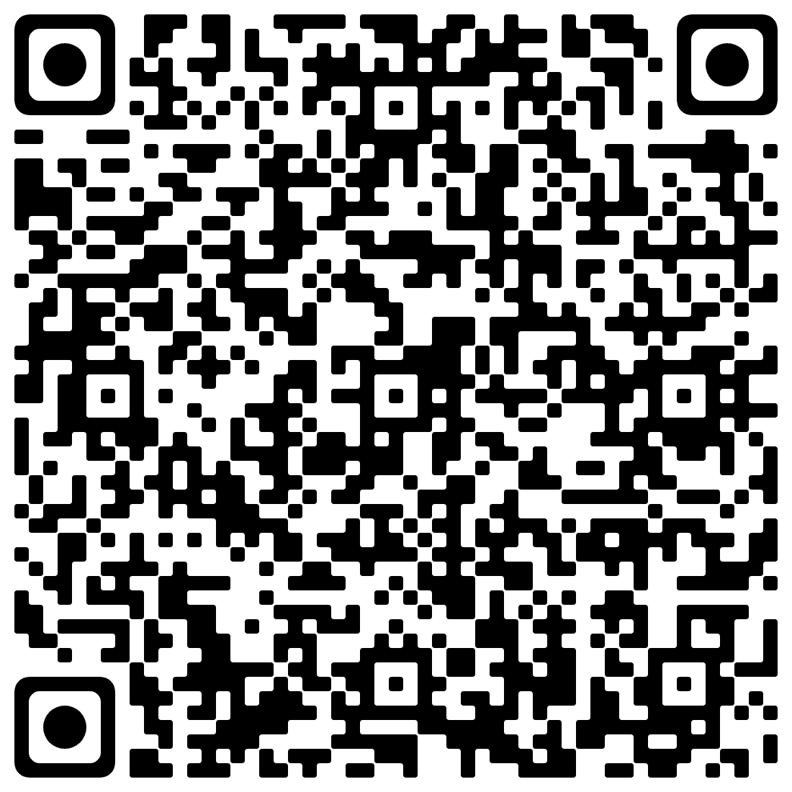
Regina.Pinkney@VirginiaHousing.com
What’s next?
Give us a call.

