Slide 1

Northern Virginia Association of Realtors®

Slide 2
NVAR.com/007

Slide 3
3 BIG Things
Verify on Google Business
Claim and fill Realtor.com Profile
Get your .realestate or .realtor (or other domain)

Slide 4



Creating An Online Presence
FIND YOU
LIKE YOU
TRUST YOU

Slide 5

Search Engine Optimization Tips
SEO is your ability to be found in search
All your websites and social media should say you are a real estate agent and Realtor®
Have your brokerage, office address, phone number, and email in all places
Link all your sites together. Update them
Have pictures, bios, and reviews
Name your listing photos with your name-address-feature

Slide 6


Slide 7
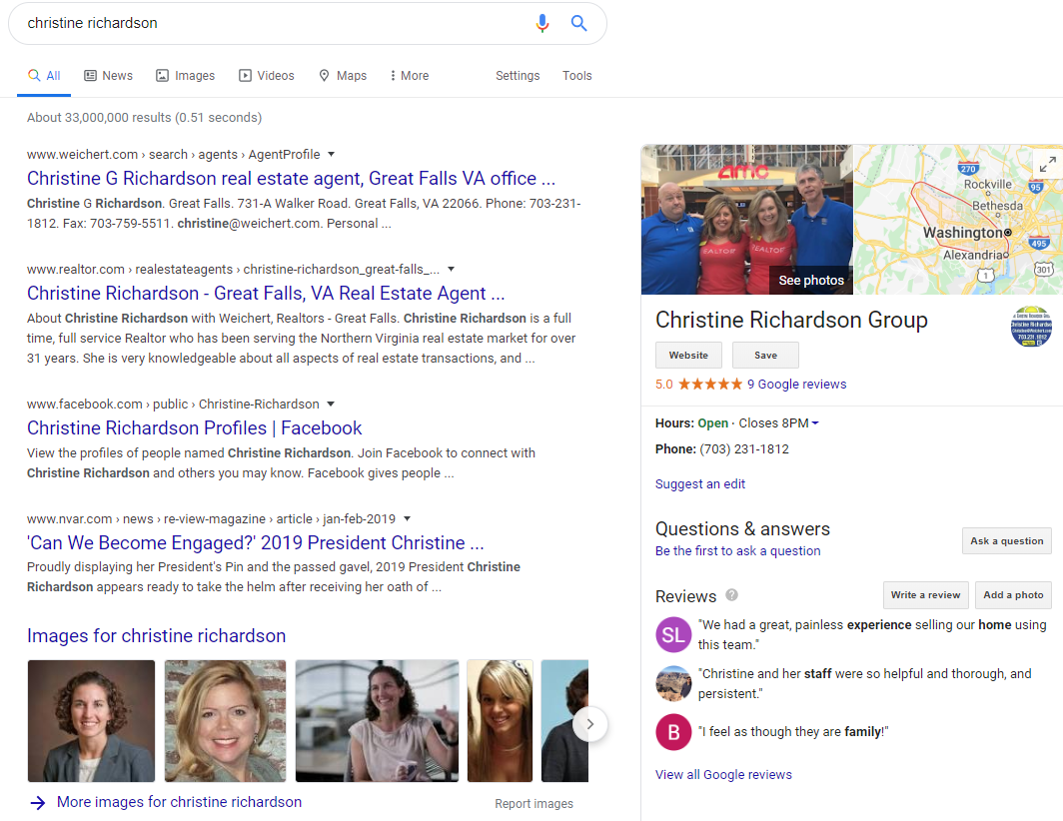
Your Goal
For
Search

Slide 8
Online Reviews
of home buyers choose a Realtor® based on online reviews and real estate agent ratings.
-Zip Realty
62%
What are the top 3 review sites for real estate agents?

Slide 9

Realtor.com Agent Profile

Slide 10
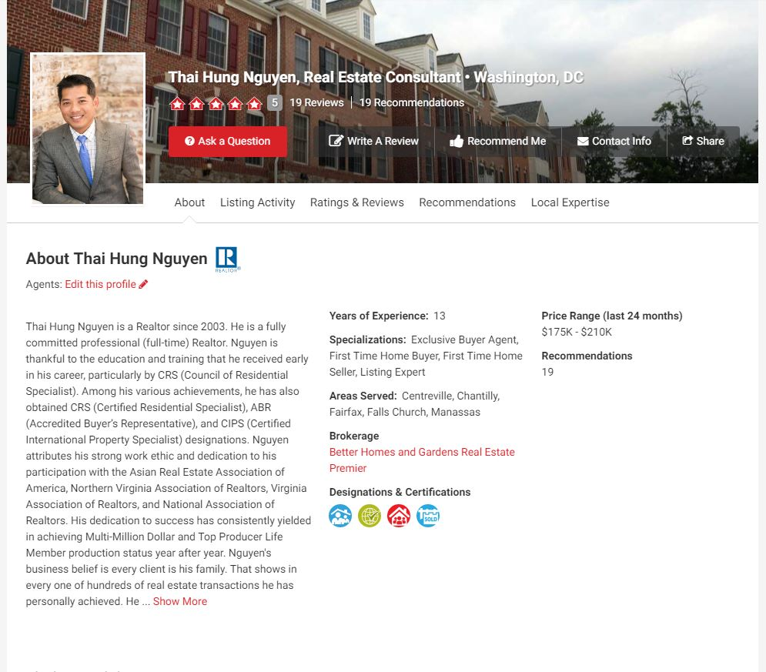
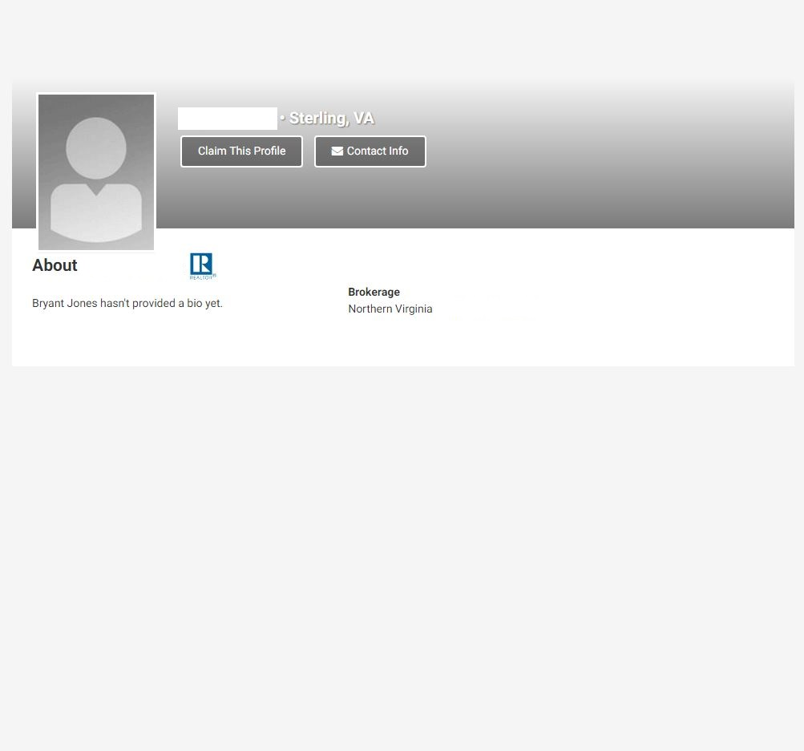

Complete vs Unclaimed Profile

Slide 11
Online Presence Question Exercise
[Name] is a [title] who works with [who you help] to [how you help them]
[Name] [knows/believes] [what you know/believe about the work you do].
[Pronoun] has [learned/created/supported/achieved] [insert experiences and wins].
[Name] is a [trained/certified/licensed/awarded] [insert trainings, awards, honors, etc.]
Who is your target audience?
What do you what them to learn from your bio?
What life events can you include to illustrate these points?
https://hub.realtor.com/resource/4-easy-steps-perfect-real-estate-agent-bio

Slide 12
Your Realtor.com® Profile
Agent Profiles present opportunity
70% of profile views come from organic Google Searches
30-35% of NVAR members have claimed their profiles
The national average of claimed profiles 25-30%
NVAR has integrated your profile into its member directory

Slide 13
Fill Out Your Profile
AT A MINIMUM:
Claim your profile
Put in your headshot and a background photo
Fill in your “About Me” section
Put in office address, phone number, your website, and social media

Slide 14
Most Valuable Information!
Past sales and current listings
Price range and geographical region of recent sales
Price history of sales, how long it took to sell/changes
Detail reviews with specific information.
*According to the CFA (Consumer Federation of America)

Slide 15
Personal Domain Options
.REALTOR domain name (i.e. LeoSellsHomes.REALTOR)
  Visit this site to claim your domain today: https://www.get.realtor/
  Realtors get their first custom domain and email address FREE for a year
Placester
  NAR Members receive a 20% discount on two different subscription packages

Slide 16



Most-Used Review Sites For Agents

Slide 17

10 Minute Break

Slide 18

Your Website & Social Media
Facebook, Twitter, and Linkedin are great ways to build your online presence
Be sure your public presence portrays the image you want
Facebook Business Pages allow you to have unlimited Likes
Content in Business Pages are searchable in Google

Slide 19

Content: NAR Realtors® Content Resource
Realtor® Content Resource

Slide 20

The Realtor® Difference
VIDEO: Highlighting the Realtor(r) Brand

Slide 21

Realtor Magazine Online
Magazine.realtor

Slide 22
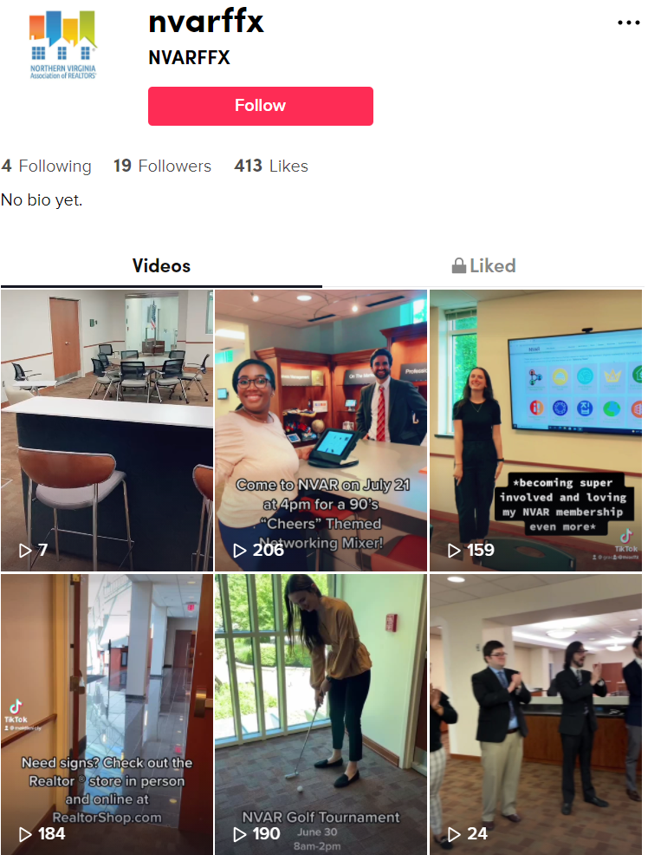

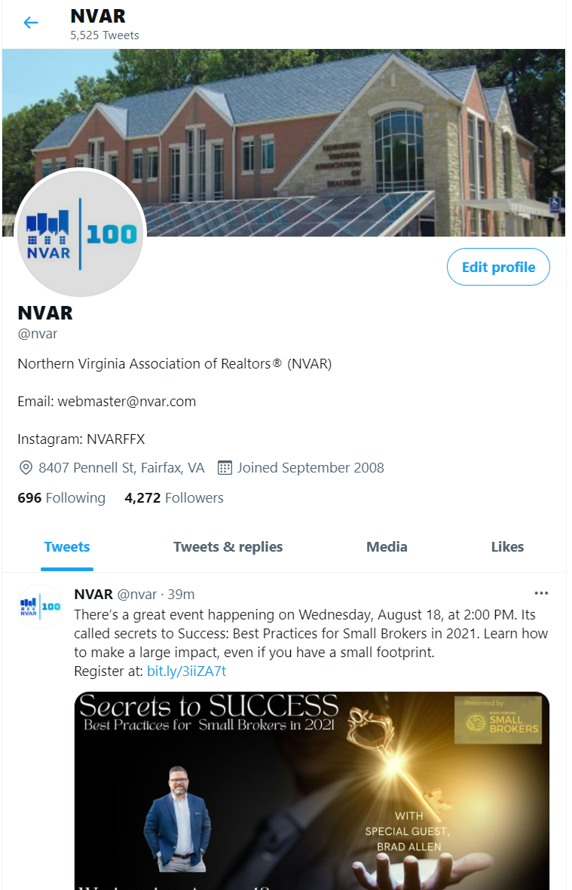


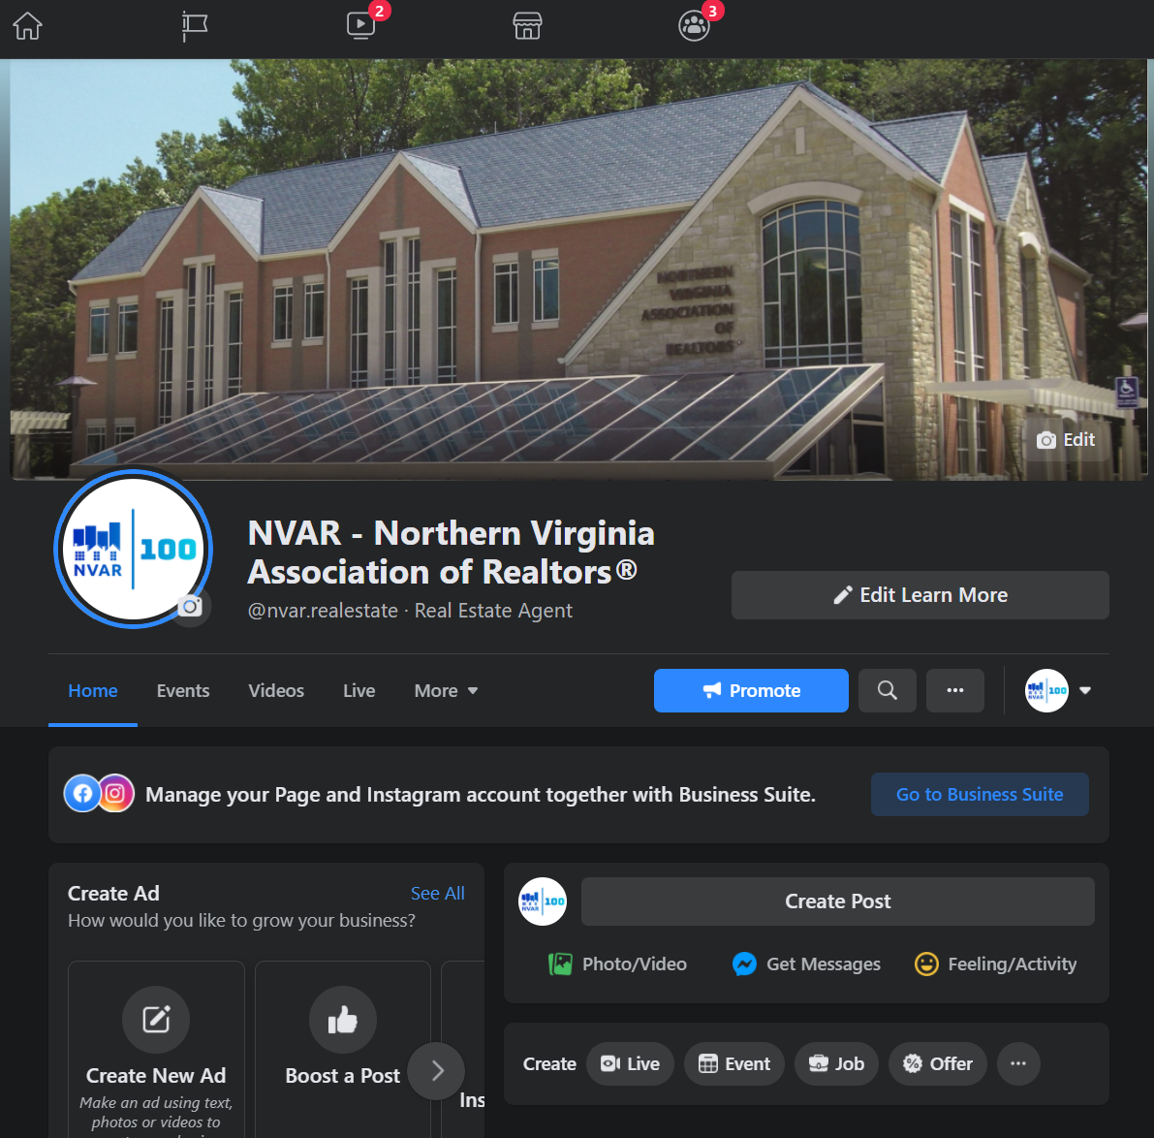


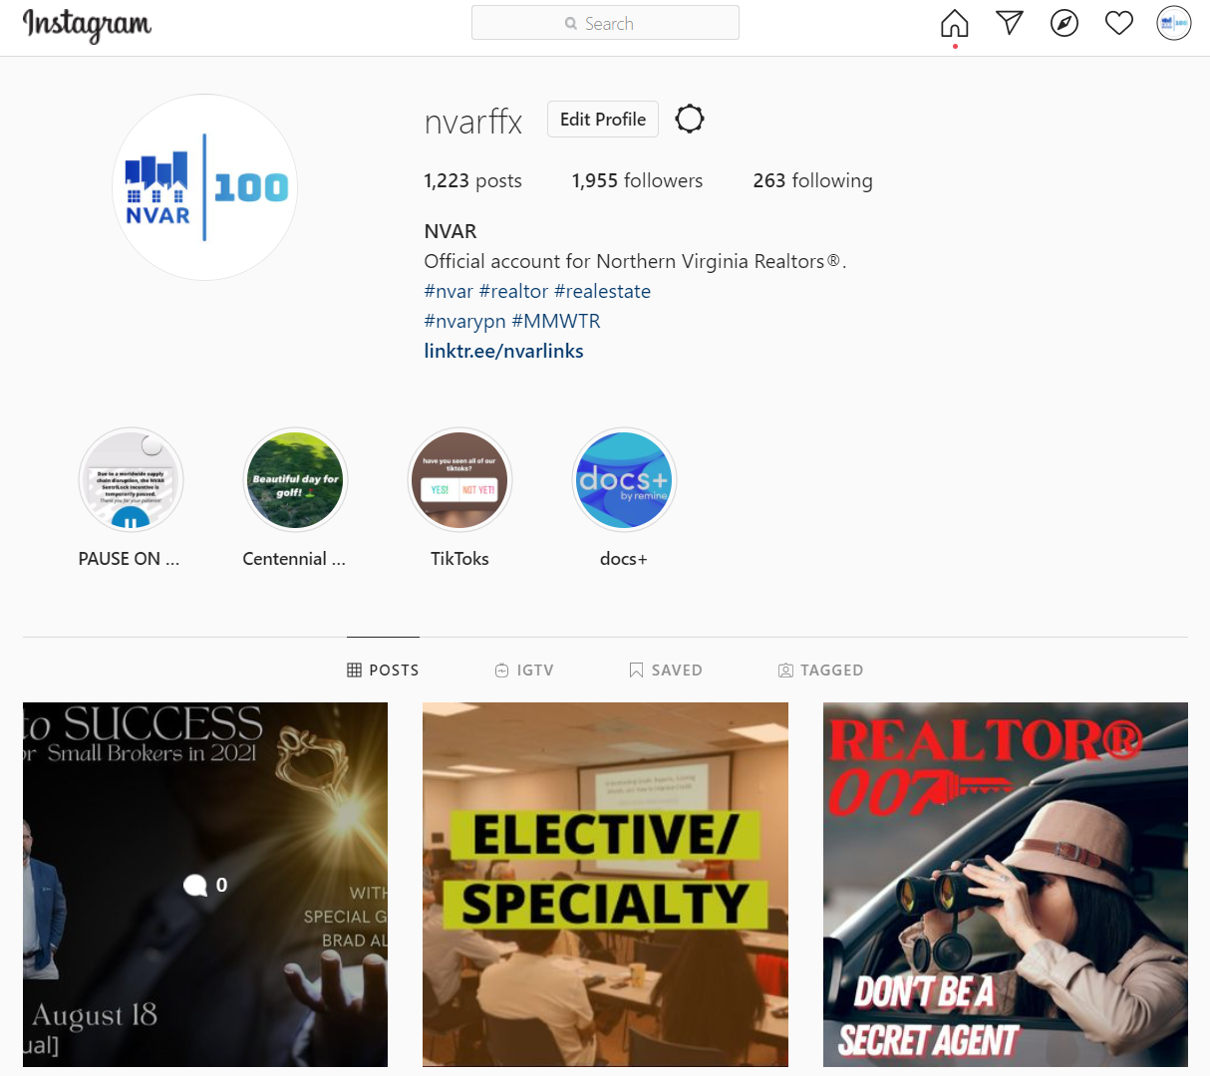
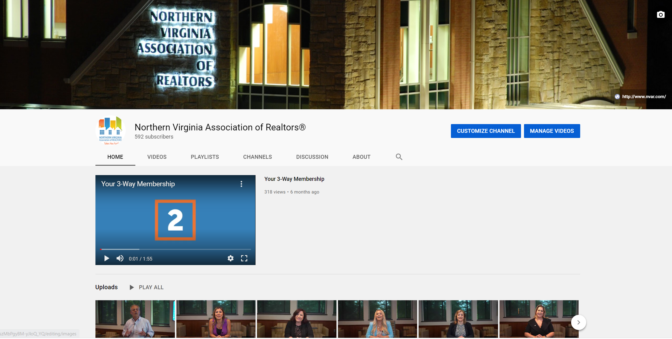
NVAR Social

Slide 23


Publications

Slide 24

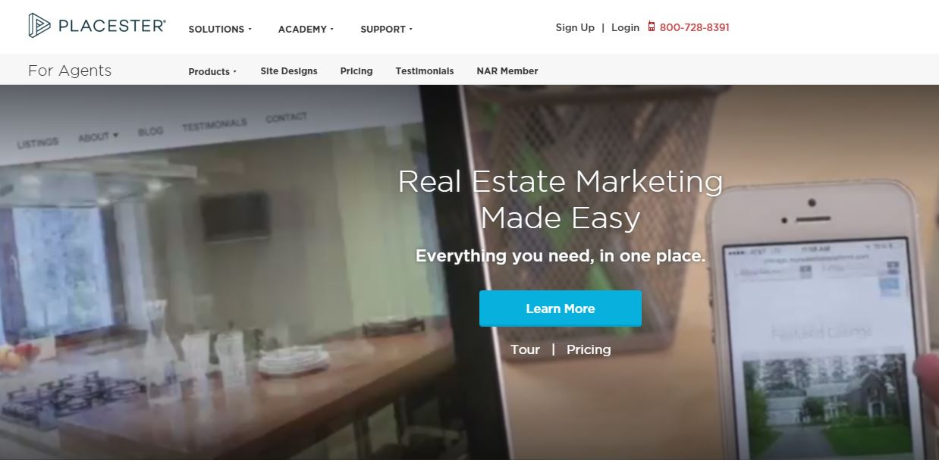
Other News Resources

Slide 25
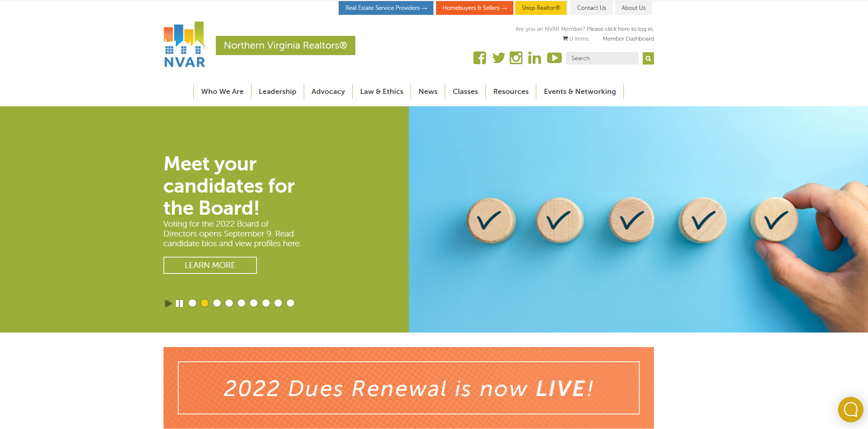
NVAR website: www.nvar.com

Slide 26


Slide 27
Shop Realtor
NVAR has reframed its products, services and service providers into 8 core competencies based on how Realtors do business
  Client Driven Solutions
  Business Driven Solutions
Every aspect of the NVAR website reflects this organization of resources for your business

Slide 28


Slide 29


SentriLock & the SentriSmart™ App
Now Integrated with RPR!

Slide 30


Slide 31
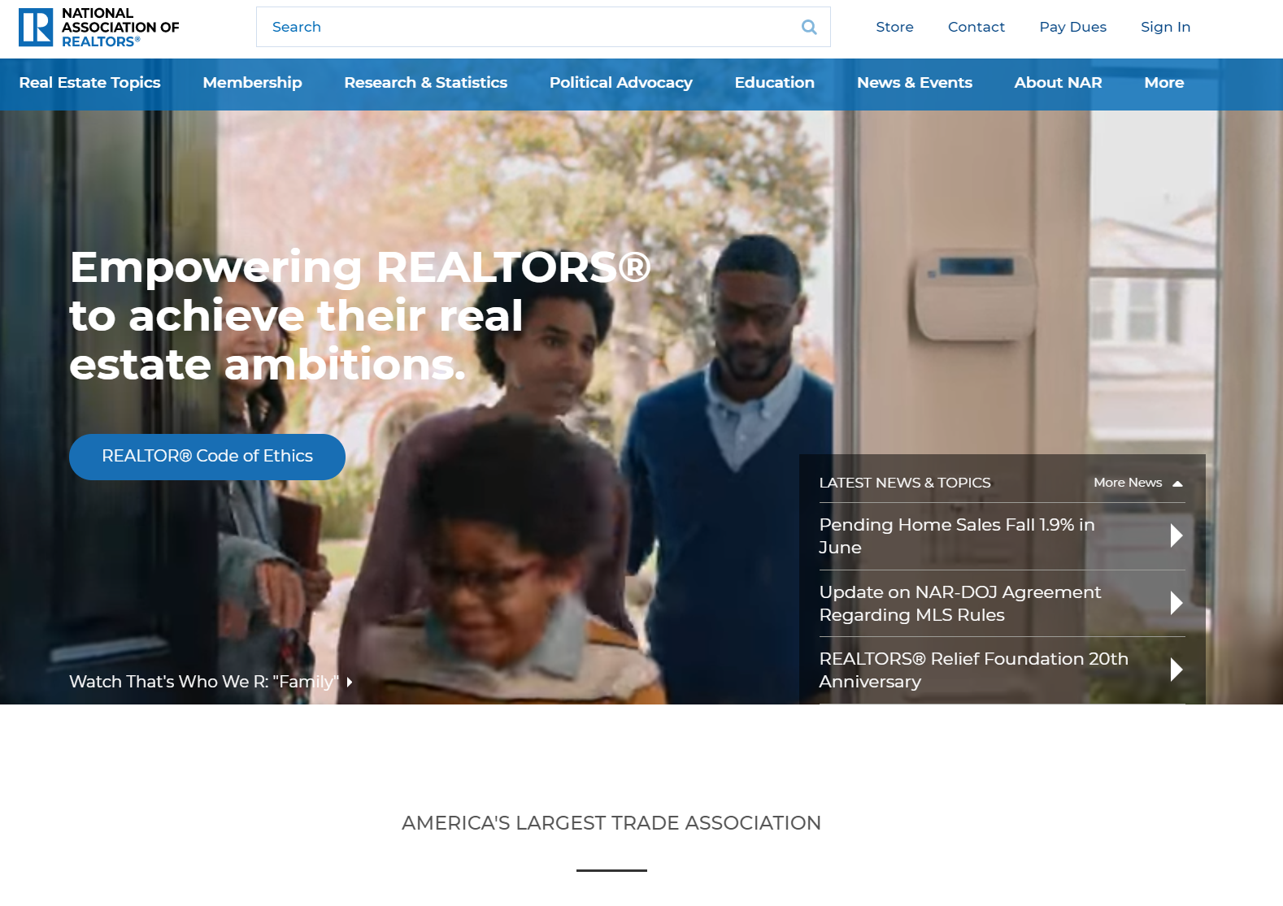
NAR.realtor

Slide 32



Slide 33

Realtors Property Resource® (RPR)

Slide 34
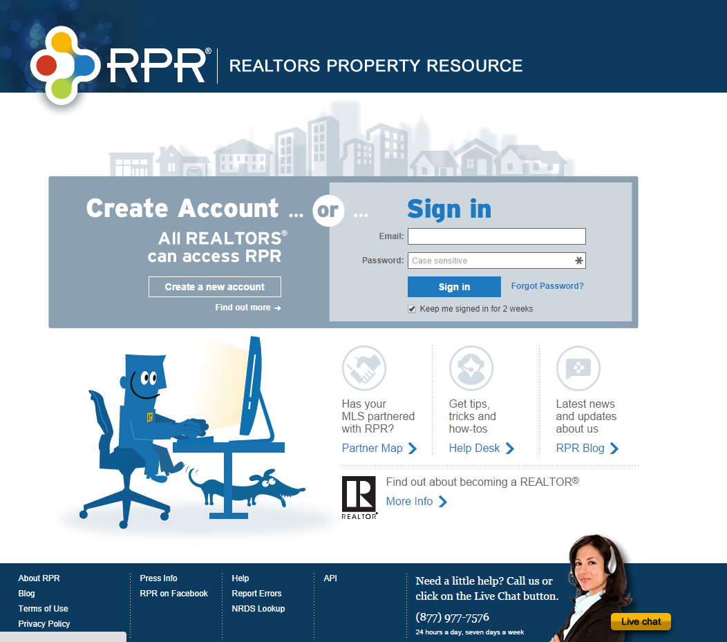

Realtors Property Resource® (RPR)
www.narrpr.com

Slide 35

Homesnap

Slide 36

Realtor Safety
http://www.realtor.org/safety
(check out “Resources for REALTORS®)

Slide 37
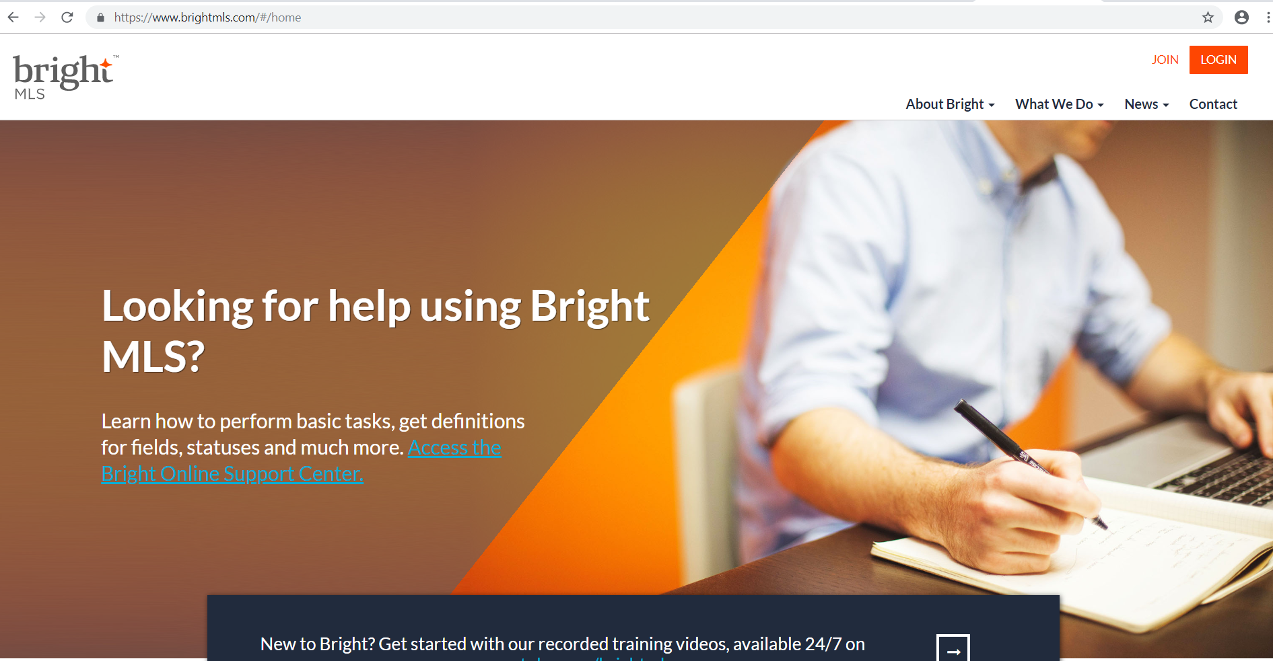
Bright

Slide 38

Tech Support available:
M-F, 9am-8pm
Sat 9am-5pm
800-276-4216
NVAR.com/TechHelp

Slide 39
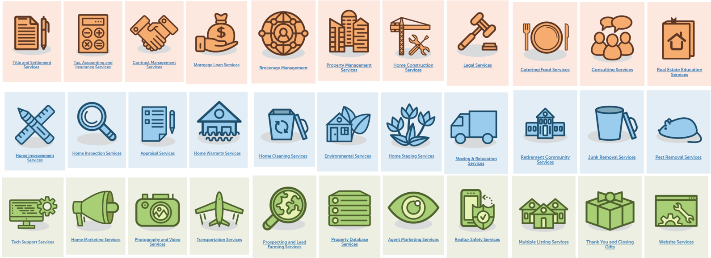
Professional & Real Estate Service Providers
NVAR.com/Services

Slide 40


Slide 41
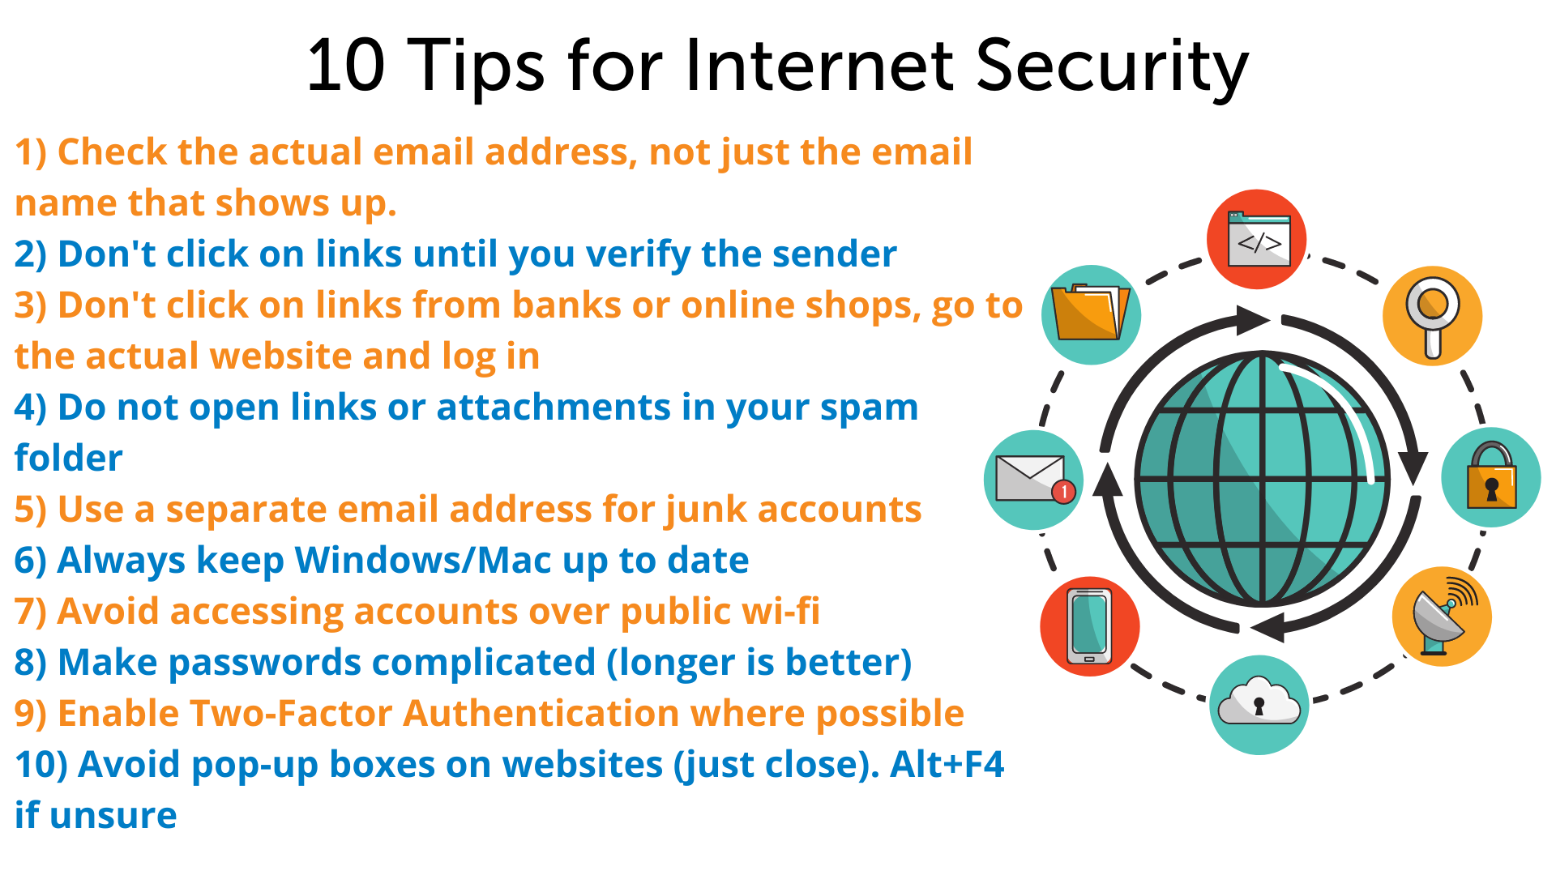

Slide 42
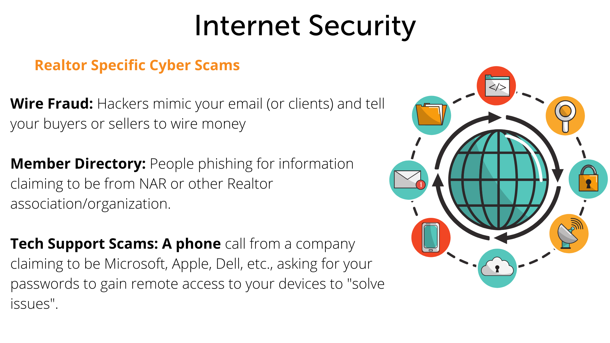

Slide 43

Don’t Be A Secret Agent!

