Slide 1



NVAR:
Discovering Affordable Housing
Northern Virginia Affordable Housing Alliance
Jill Norcross
Executive Director
jill.norcross@nvaha.org
www.nvaha.org

Slide 2

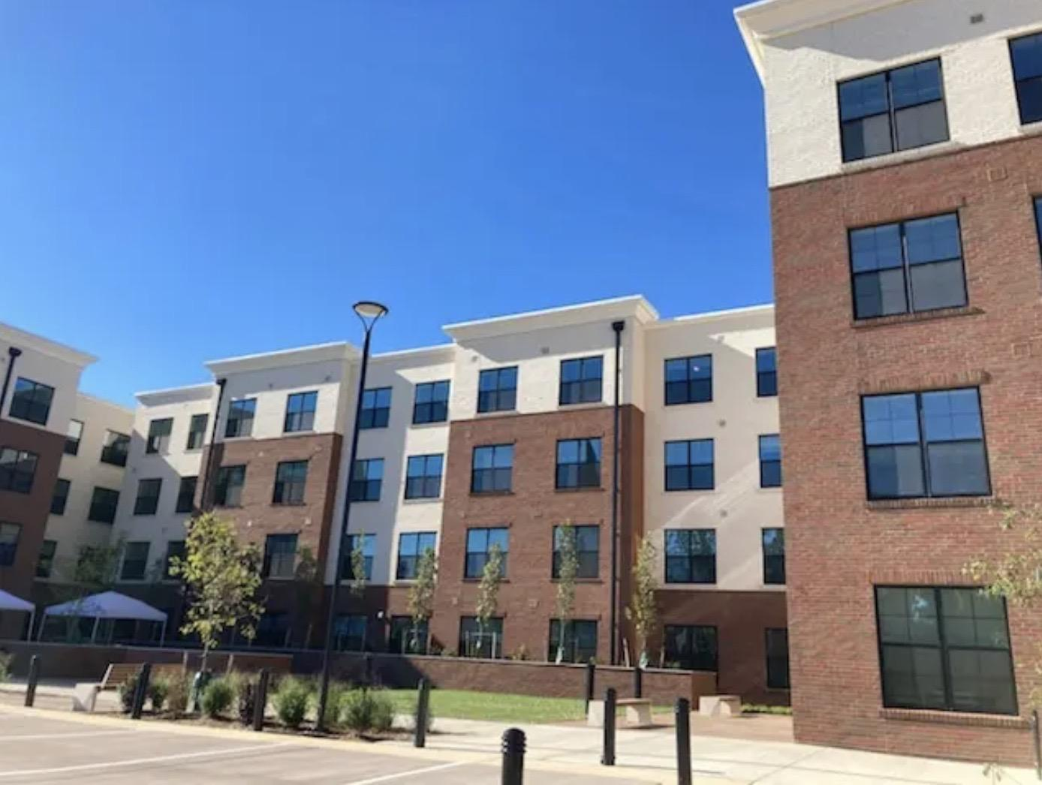
NVAHA Mission
The mission of the Northern Virginia Affordable Housing Alliance is to promote healthy, sustainable and equitable communities that meet the diverse housing needs of Northern Virginia residents.
Advocating for public policies and adequate financial investments to develop and preserve housing that’s affordable
Building political will to advance affordable housing
Partnering with underserved communities to lift their participation in our civic discourse
Calling for the deconstruction of land use systems and policies that perpetuate inequities
Conducting research on housing needs and policies

Slide 3
Definitions
What is Affordable Housing?
Housing is considered affordable if an individual or family spends no more than 30% of their gross monthly income on housing. Range of affordable housing because we have a range of incomes. Affordable housing can be rental or homeownership.

Slide 4
Northern Virginia
What does that mean in our region?
Usually affordable housing resources are targered toward low-to-moderate income households, usually those earning 60% to 80% of the area median income (AMI). Northern Virginia is part of the DC-Arl-Alex Metropolitan Statistical Area (MSA). The AMI for our region is $152,100 for a family of four, and $106,500 for a single person household.
In FY23, 60% of the AMI for a family of four DC-Arl-Alex MSA was $90,420 and 80% of the AMI for a family of four is $120,560. (HUD guidelines are even lower for 80% AMIs)
NLIHC establishes a Housing Wage of $34.33/hour (DC-Arl-Alex MSA) to afford the average 2 bedroom apartment. Virginia minimum wage is $12/hour.

Slide 5

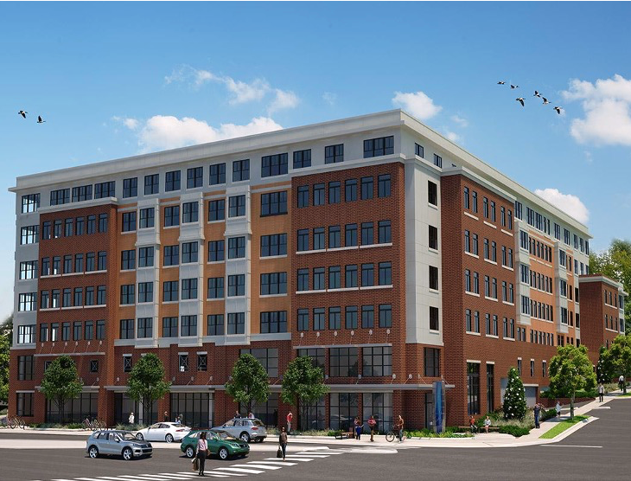
2030 DMV Regional Housing Goals = 374,000
  MWCOG & Urban Institute
  Produce 25,000 new units annually
  Locate housing in activity centers
  75% of annual production (18,750 units) should be affordable to low- and moderate-income households

Slide 6
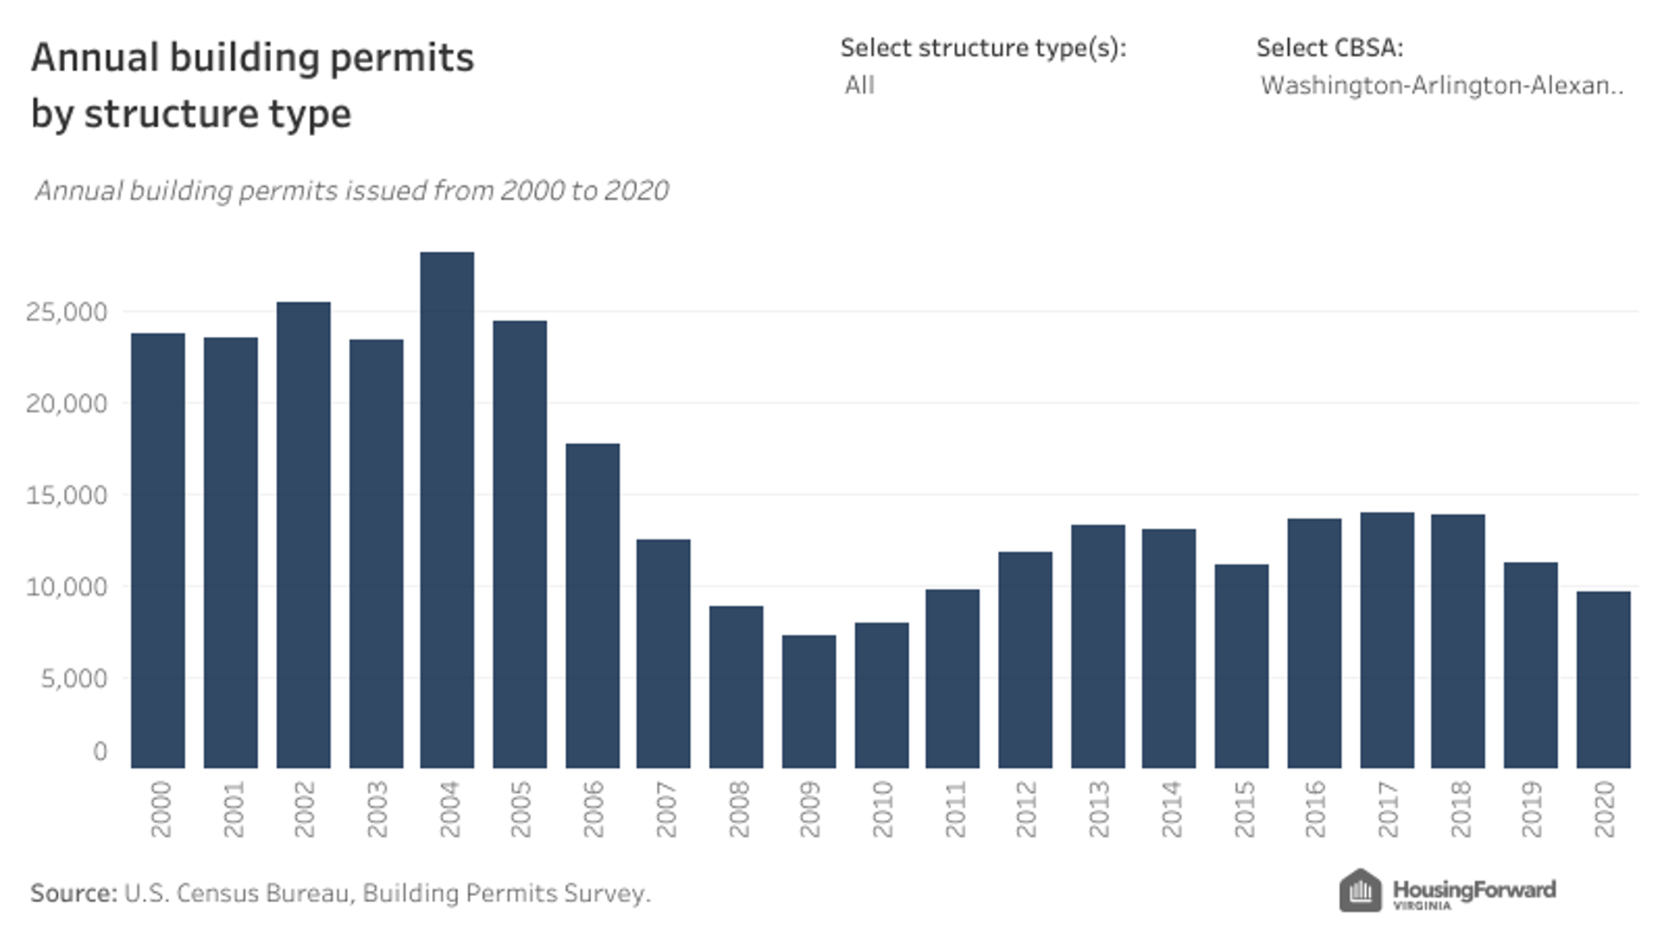

Slide 7



Housing Finance
Affordable Multifamily/Rental
& Homeownership
Federal
Subsidy Programs
State
Subsidy Programs
Local Subsidy Programs
  Mortgage Interest Deduction (IRS)
  Low Income Housing Tax Credits – LIHTC (IRS)
  Housing Choice Voucher (HCV)
  HUD Block Grant Programs
  Other Tax Credit Programs
  Private Activity Bonds
  Virginia Housing Trust Fund
  National Housing Trust Fund
  Permanent Supportive Housing (PSH)
  First Time Homebuyer Programs
  Local Housing Trust Fund
  Local Rental Subsidy
  First Time Homebuyer Programs
  Community Land Trusts

Slide 8










GOVERNMENTS CAN'T DO IT ALONE
Private sectors partners should invest in the community
Housing for the workforce
Housing is infrastructure
Housing is inextricably connected to economic development and resiliency
Community Partners (below market loans, grants or land)
  Corporate Partners - Amazon | Washington Housing Initiative (JBG SMITH)
  Healthcare institutions - Kaiser Permanente & CVS
  Community Foundations - Local, Meyer, Cafritz, WRAG
  Higher Education – George Mason & Howard University
  Houses of Worship - Faith Communities using land for AH

Slide 9
Racial Homeownership Gap = Racial Wealth Gap
There is a $156,000 gap in median home value between Black and white residents in the DMV.
Additionally, Black residents are nearly two times as likely to be rent-burdened.
Both of these factors contribute to the difficulties Black residents experience when trying to accumulate generational wealth through homeownership.
--Brookings Institution, Economic disparities in the Washington, D.C. metro region provide opportunities for policy action, April 27, 2022

Slide 10
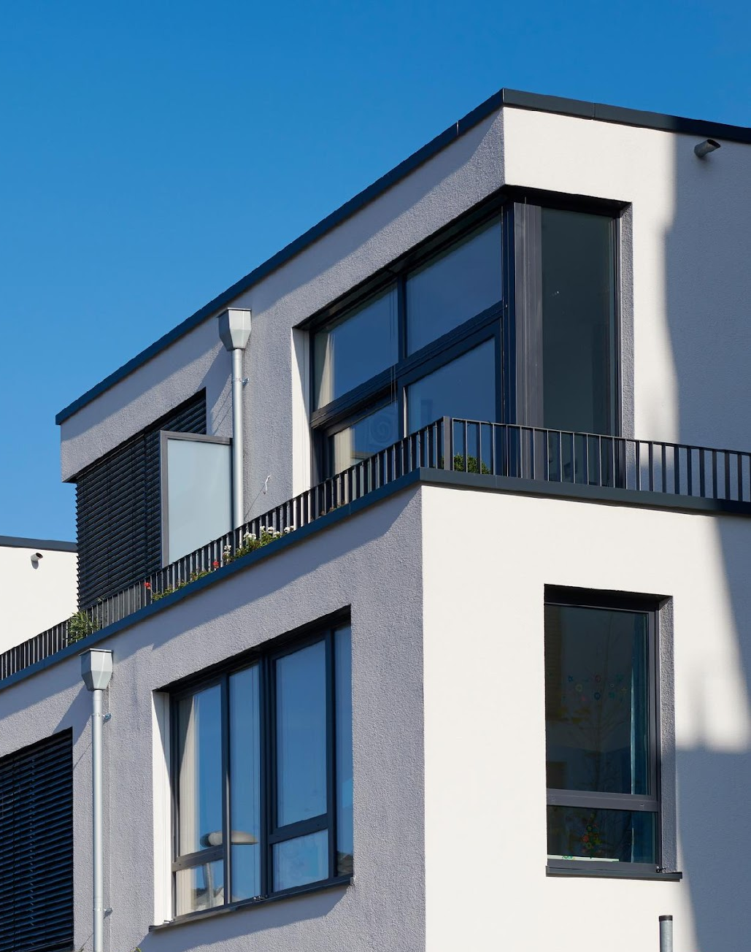
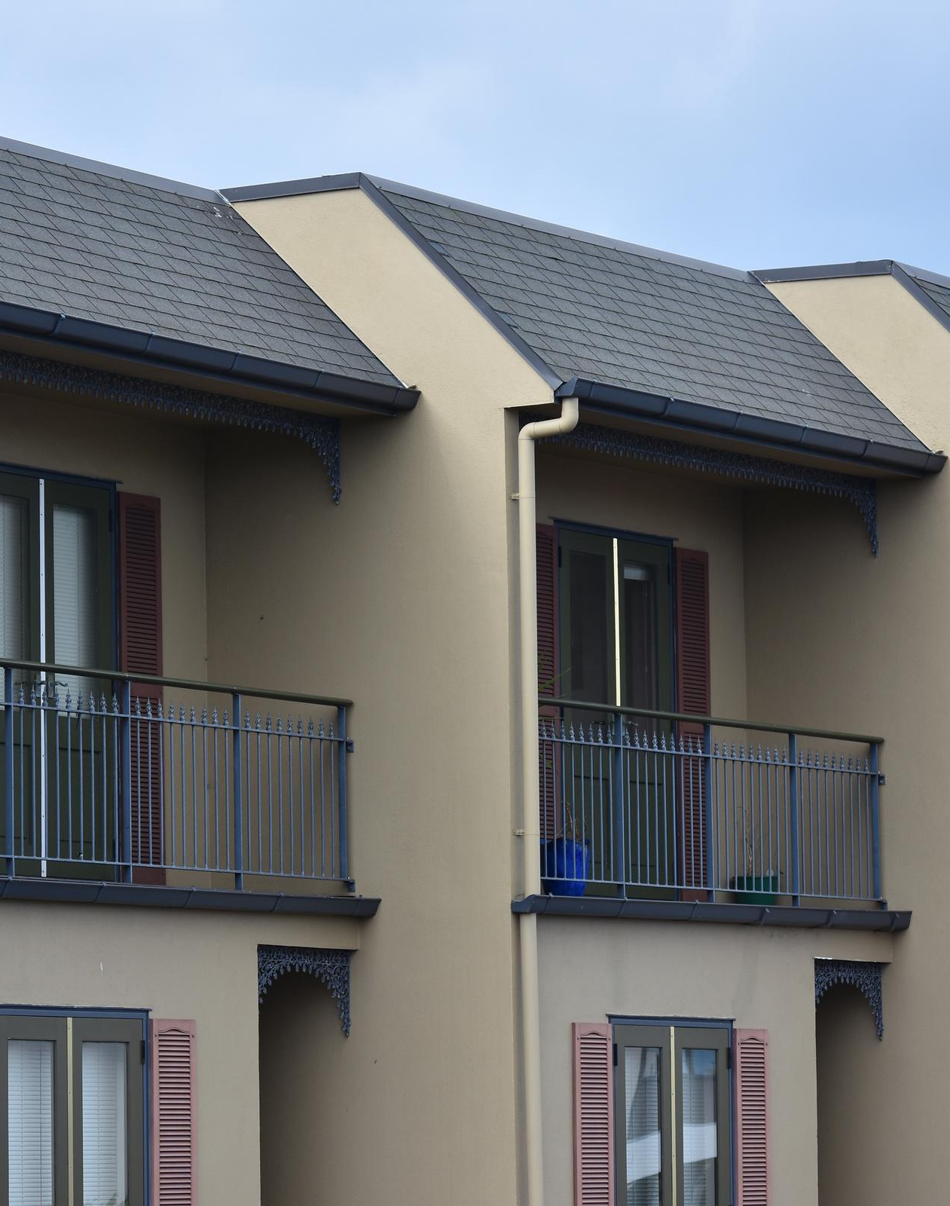
EXPECTATIONS FOR AFFORDABLE HOUSING IN NOVA
Built to the same standards at market-rate housing
  Architecture compatible with surrounding community
  Meets green development building standards
  Address storm water management; resource protection areas
Additional priorities which increase costs
  Larger units to accommodate families (2 Bd + den, 3 Bd)
  Priority to locate near transit – where land is most expensive
  Priority to serve households earning less than 60% AMI – real need is below 50%

Slide 11
Thank you!
Northern Virginia Affordable Housing Alliance
Jill Norcross
Executive Director
jill.norcross@nvaha.org
www.nvaha.org

