Slide 1
NVAR
Discovering Affordable Housing
June 29, 2023
Fairfax County Department of Housing and Community Development
Abdi Hamud, Senior Program Manager,
Homeownership and Relocation Services Division
https://www.fairfaxcounty.gov/housing/

Slide 2
The Fairfax County Redevelopment and Housing Authority (FCRHA) spearheads the county’s effort to develop and preserve affordable housing and administers a variety of assistance programs that enable residents to find and remain housed.
The powers of the FCRHA are vested in eleven Commissioners appointed by the Fairfax County Board of Supervisors (BOS), and as provided for by the Code of Virginia.
About the FCRHA and the Fairfax County Department of Housing and Community Development

Slide 3
The FCRHA is a separate political body from the Fairfax County Government and possesses specific powers granted by state law (some examples include the ability to issue bonds, purchase property, and make loans).
The Fairfax County Department of Housing and Community Development (HCD) serves as staff for the FCRHA and administers housing and community development programs on behalf of the BOS.
About the FCRHA and the Fairfax County Department of Housing and Community Development

Slide 4
Affordable Housing Development and Preservation Goals
In 2019, the Board of Supervisors initially adopted a communitywide goal of developing 5,000 new affordable homes by the year 2034.
As a result of successes to date, the affordable housing development goal was increased by the BOS in March of 2022 – now to create 10,000 new affordable housing units for households earning up to 60 percent of area median income by the year 2034.
Importantly, the BOS also adopted a goal of no net loss of affordable units in Fairfax County.
This commitment to preservation ensures that while the County expands the number of affordable homes through development, we are also simultaneously maintaining the existing stock of affordable homes.

Slide 5
Affordable Housing Development
Together, the FCRHA and BOS are using public land, leveraging funds, and working closely with private sector investors to meet the County’s affordable housing goals.
The FCRHA released a Notice of Funding Availability for $52 million for Fiscal Year 2023; this is now fully committed.
Currently, there is approximately 1,000 affordable homes under construction and over 2,000 homes in the development pipeline.

Slide 6
Projects Under Construction
(as of February 2023)
Projects | District | Project Type | No. Units | Status
North Hill | Mount Vernon | New - PPEA | 279 | Complete – Spring 2023
Ovation at Arrowbrook | Dranesville | New - Finance | 274 | Complete – Spring 2023
Oakwood | Franconia | New - PPEA | 150 | Complete – Summer 2023
One University | Braddock | New - PPEA | 240 | Complete – Summer 2024
Braddock Senior | Braddock | New – Finance | 80 | Construction start – Fall 2022
TOTAL |  |  | 1,023

Slide 7
Development Pipeline
(as of February 2023)
Projects | District | Project Type | No. Units | Status
Stonegate Village | Hunter Mill | Preservation | 234 | Design
Autumn Willow | Springfield | New - PPEA | 150 | Close – Spring 2023
West Ox/Route 50 | Sully | New - PPEA | 34 | In land use process
Little River Glen IV | Braddock | New - HCD | 60 | Bid Advertisement
Little River Glen Renovation | Braddock | Preservation | 120 | Bid Advertisement
Dominion Square West | Hunter Mill | New-Partnership | 516 | Early Construction - Summer 2023
Somos at McLean Metro | Providence | New-Partnership | 450 | Design/Permitting
Residences at the GC II | Braddock | New - PPEA | 275 | Design/Permitting
Penn Daw (housing component) | Mount Vernon | New - County | 60 | Design
Franconia GC Redevelopment | Franconia | New - PPEA | 120 | In land use process
TOTAL |  |  | 2,019
*In addition, there are nearly 700 units in the predevelopment and procurement pipeline.

Slide 8
Affordable Housing Preservation
Over 1,000 units have been preserved since the BOS adopted the “no net loss” goal.
The BOS recently adopted new guidance that will be added to the County’s Comprehensive Plan regarding the preservation of existing, affordable rental housing. The amendment promotes the goal of one-for-one replacement of affordable units in redevelopment and infill development applications by leveraging incentives such as allowing building height or density above current Comprehensive Plan guidance.
New market affordable study was released in the Fall of 2022. Showed a decline from 2019 in the number of market affordable units and properties in the County.

Slide 9
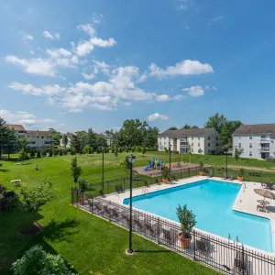
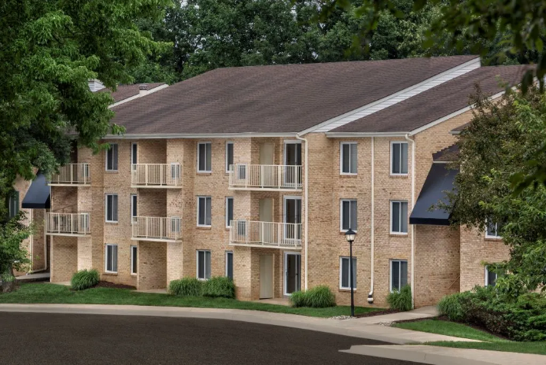
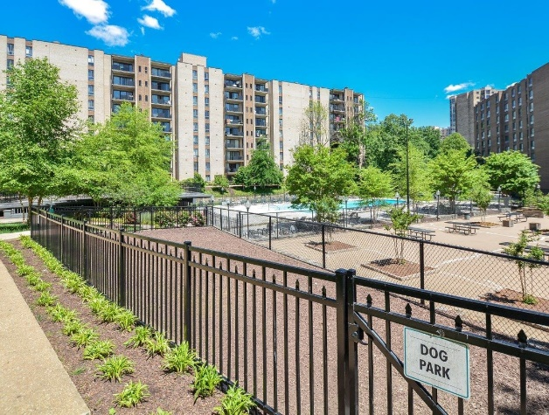
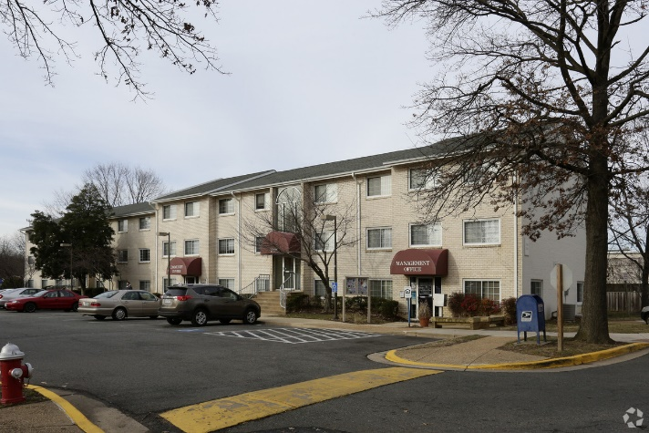
Affordable Properties Preserved
(as of the end of 2022)
Total Preservation Units: 1,321
Landings I and II
Acquired by AHC
$3M Blueprint
$7.8M Amazon REACH
292 units
Colvin Woods
Acquired by AHC
$15M Blueprint
259 units
Cityside
Acquired by Lincoln Avenue Capital
Amazon financing
570 units
Murraygate
Renovated by FCRHA
200 units
Notes:
Landings I and II – 292 units
Colvin Woods – 259 units
Cityside – 569 units
Murraygate – 200 units, completed renovation
Total of 1,321 units in the past two years

Slide 10
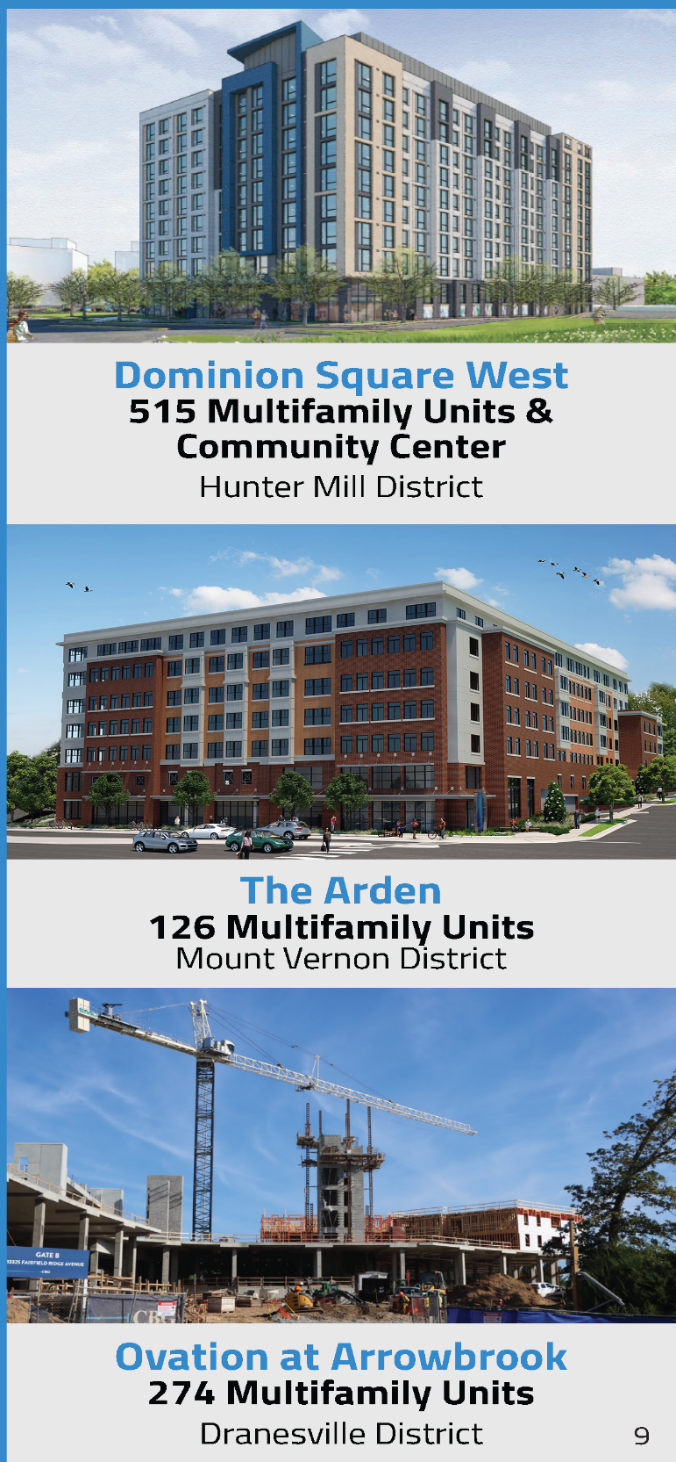
Financing Affordable Housing
Within the last fiscal year, the FCRHA and Fairfax County have worked to responsibly make strategic investments to develop and preserve affordable housing.
Local Resources - $142.2 million (FY 2022)
Affordable Housing Development and Investment Fund
FCRHA Funds
FCRHA Bonds
Tysons Housing Trust Fund (Proffer Financing)
Federal Funds - $15.9 million (FY 2022)
American Rescue Plan Act
Community Development Block Grant
HOME Investment Partnerships Program

Slide 11
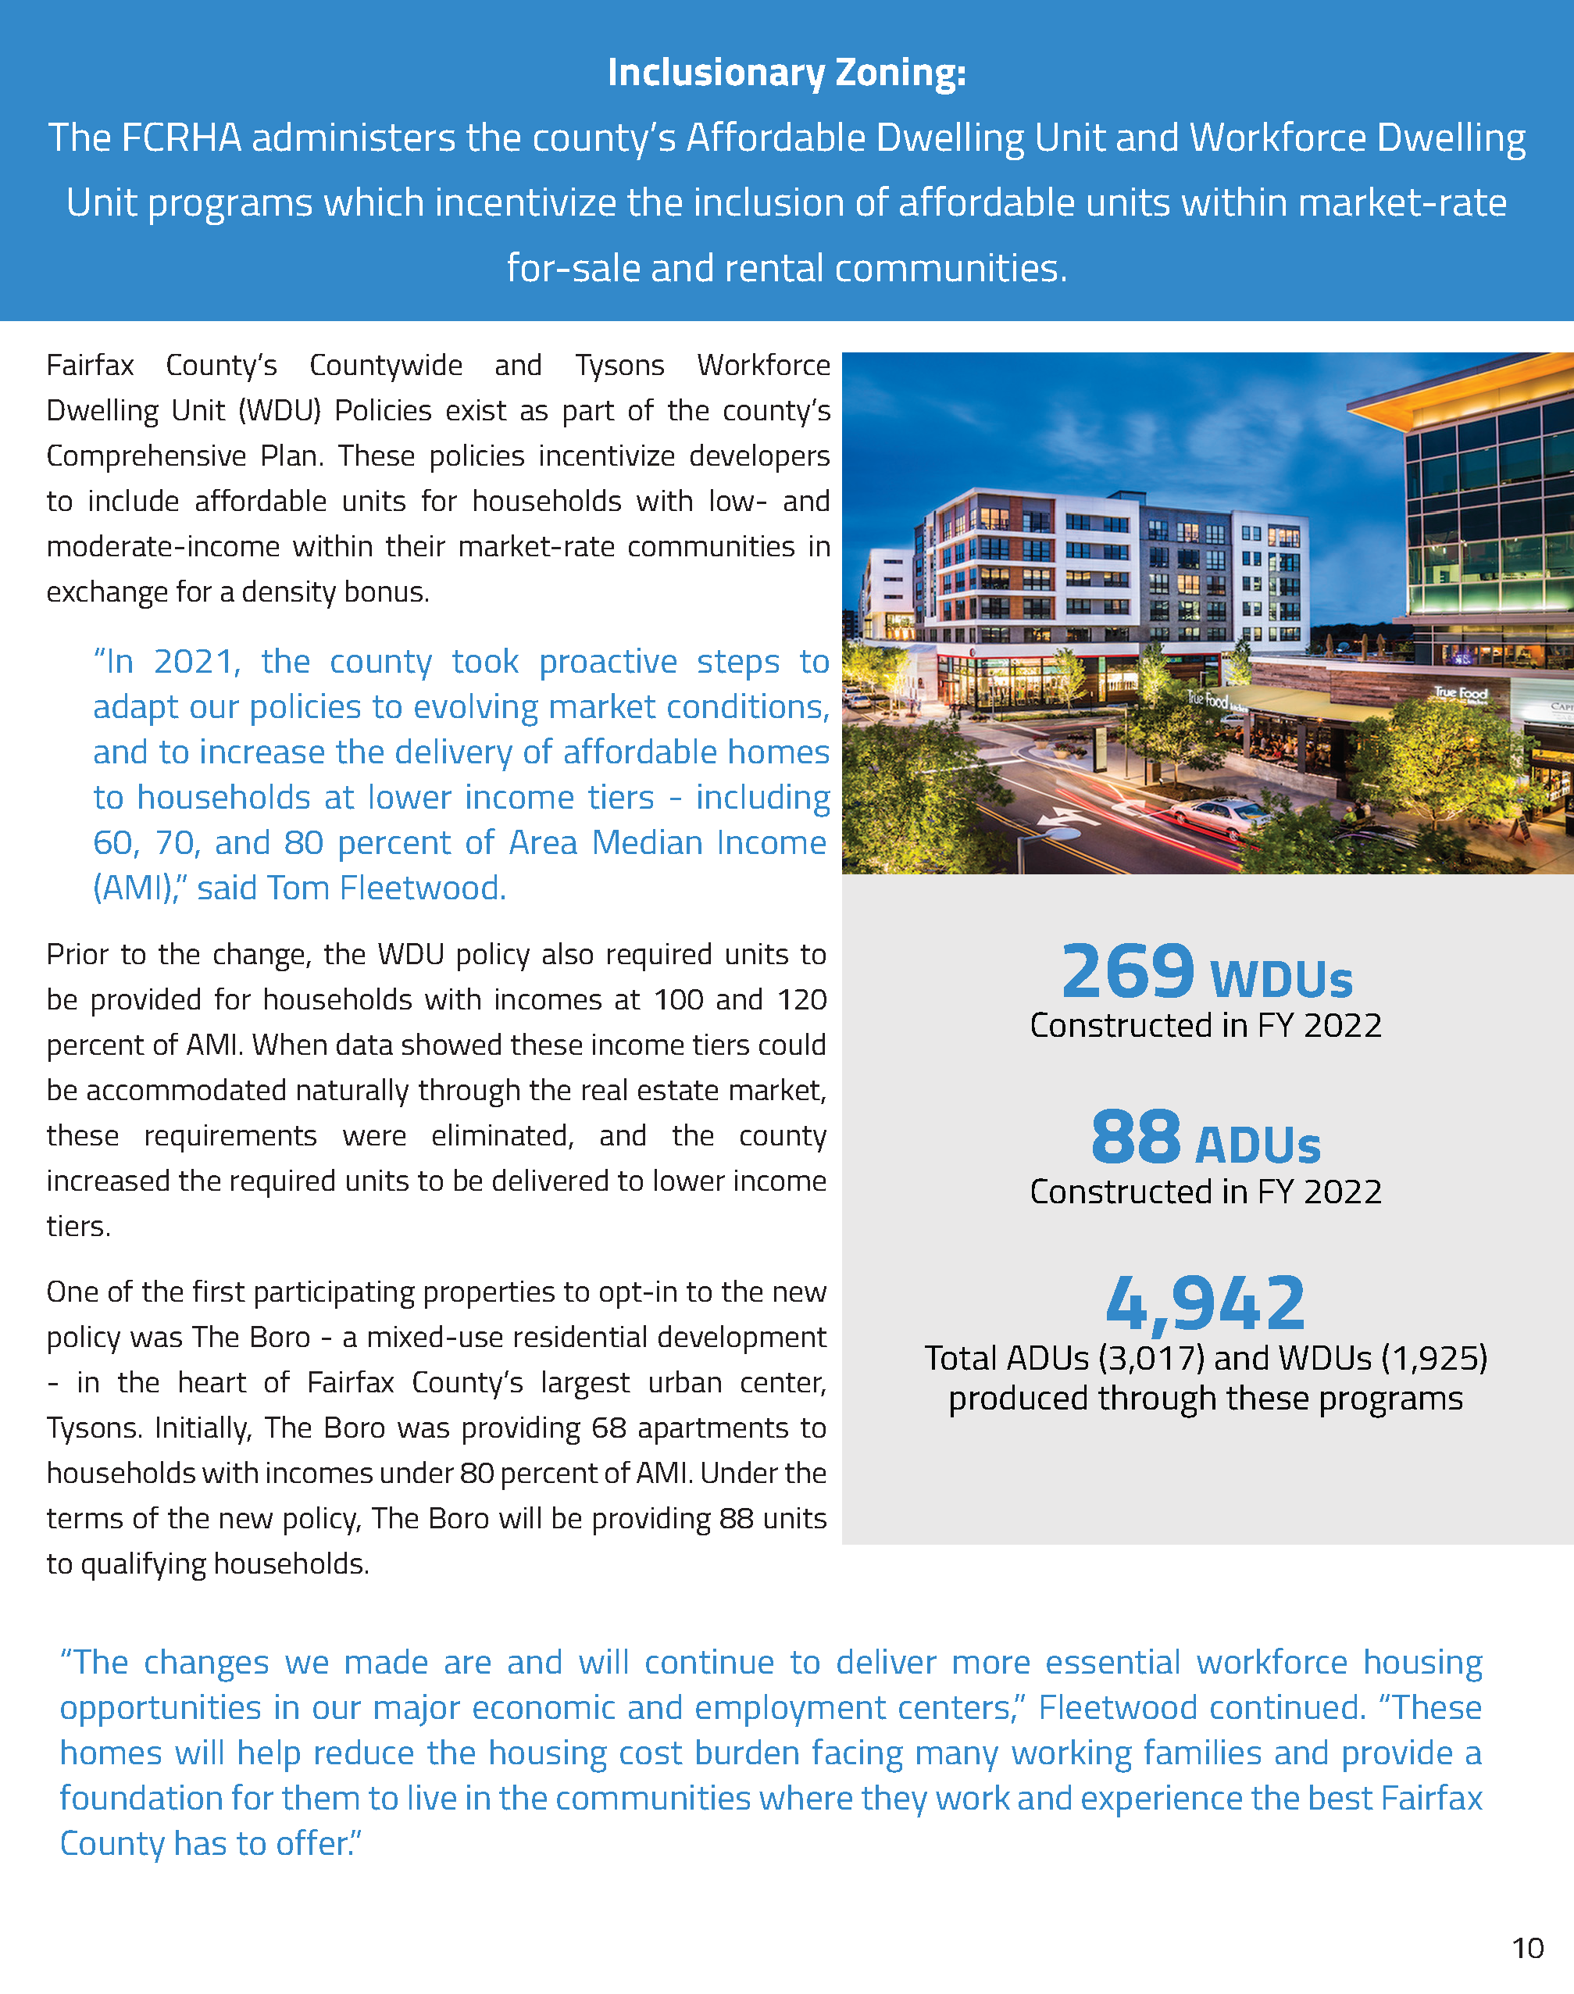
Inclusionary Zoning
The FCRHA administers the county’s Affordable Dwelling Unit and Workforce Dwelling Unit programs which incentivize the inclusion of affordable units within market-rate for-sale and rental communities.
In FY 2022:
269 Workforce Dwelling Units (WDU)s were constructed
88 Affordable Dwelling Units (ADUs) were constructed
A total of 4,942 units have been produced through these programs (3,017 ADUs and 1,925 WDUs)

Slide 12
Affordable Homeownership
The FCRHA provides qualified residents with opportunities to purchase homes at below-market prices and provides down payment assistance, reduced interest rates, and homebuyer education resources.
In FY 2022, the FCRHA:
Assisted 71 new homebuyers
Issued $560,000 in down payment assistance
Sponsored over $11 million sponsored in first-trust
mortgage assistance

Slide 13
Rental Housing Subsidies
The administration of federal rental subsidies, authorized by the
U.S. Department of Housing and Urban Development, is one of the cornerstone activities of the FCRHA. Rental subsidies provide thousands of Fairfax County residents with resources needed to rent a home in the private market.
In FY 2022, the FCRHA:
Administered over 5,000 vouchers
Served over 12,000 persons through rental assistance
Contributed more than $5.5 million each month into the local economy through subsidies

Slide 14
Fairfax County Rental Program
The FCRHA owns nearly 4,000 units of affordable rental housing which serve low-income working families, individuals with disabilities and older adults.
In FY 2022, the FCRHA owned and/or managed:
505 independent living units for older adults
2,121 multifamily units
112 assisted living units for older adults
For older adults in particular, the Fairfax County Rental Program can provide a key opportunity to find an affordable home within the communities they have been a part of for years.

Slide 15
Specialized Rental Assistance
The FCRHA administers rental subsidy programs which assist individuals with specialized needs including veterans, individuals with disabilities, and those experiencing or at risk of becoming homeless.
In FY 2022, the FCRHA served:
55 households in the Rental Subsidy and Services Program
169 households who received an Emergency Housing Voucher
155 households through the State Rental Assistance Program Vouchers program
133 veterans through the Veterans Affairs Supportive Housing Vouchers program

Slide 16
Affordable Housing Resources
https://www.fairfaxcounty.gov/housing
https://www.fairfaxcounty.gov/housing/rentalhousing
https://www.fairfaxcounty.gov/housing/rentalhousing/privately-owned
https://www.fairfaxcounty.gov/housing/homeownership

Slide 17
Questions/Comments

