Slide 1
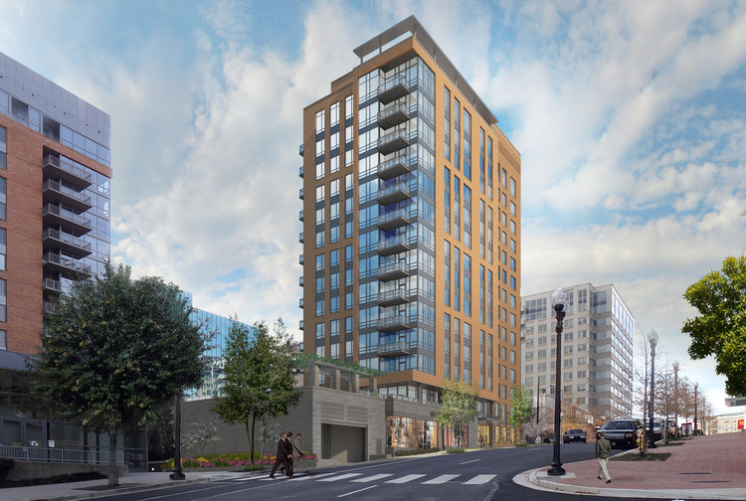
Arlington County
Homeownership Programs
Northern Virginia Association of Realtors
June 29, 2023

Slide 2
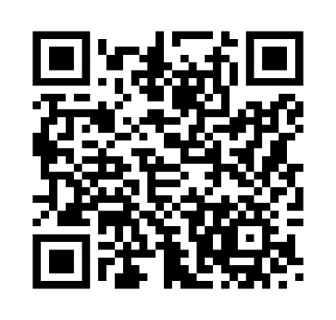
Arlington County Homeownership Study
Working to develop Program Goals and Vision
Develop specific program recommendations
Collecting feedback via an online form and in-person opportunities
Conducting a study of Existing Homeownership Programs

Slide 3
Moderate Income Purchase Assistance Program (MIPAP)
Down payment and closing cost assistance loan
Up to 25% of purchase price
Silent second trust mortgage
Shared Appreciation Model
Maximum loan $112,500
Maximum Purchase Price $500,000

Slide 4
MIPAP Income Eligibility
Maximum Gross Household Income equal or less than 80% AMI (includes all income sources)
Household Size | 2023 Income Limits
1 | $84,400
2 | $96,480
3 | $108,560
4 | $120,560
5 | $130,240
Maximum income for all adults in household to be verified through tax and employment records and may include additional sources.
Household size means every household member (adult/child/dependent). Regardless of whether they are a borrower on the mortgage.

Slide 5
MIPAP Borrower Eligibility (Must be met at the time of application)
First Time Homebuyer or have not owned a home in 3 years
80% AMI Maximum Income
660 Minimum Credit Score
45% DTI
1% Minimum Buyer Contribution (not including gifts)
Homebuyer Education Required (online or in-person)
1st Trust Pre-Approval
$14,999 Maximum Gift Amount
Must obtain MIPAP approval PRIOR to Ratified Contract

Slide 6
MIPAP Property Eligibility
$500,000 Maximum Purchase Price
Arlington County Location
(co-ops not eligible)
Primary Residency Requirement until repaid
Must meet HUD Basic Habitability Inspection

Slide 7
MIPAP Loan Parameters
30-Year 2nd Trust Loan (1st Trust must be fixed conventional)
May be repaid at any time prior to 30-year term (e.g. refinance)
Appreciation Share due at repayment
Silent Loan – No Interest. No Monthly Payments
Shared Appreciation = Proportionate % of Original Purchase Price
Documents:
Deed of Trust
Promissory Note
HUD Funding Agreement
Condo Rider
Most common layers:
VH ∙ SPARC
VH ∙ DPA
FHLB

Slide 8
Without MIPAP
Sales Price: $500,000
Credit Score: 660
Household Size: 3
Income: $105,000
3% downpayment
Details of Purchase
Purchase Price | $500,000
Closing Costs / Prepaids | $15,707
First Mortgage @ 97% | $485,000
Funds Required at Closing | $30,707
Total Housing Payment
P & I | $3,433
Taxes & Insurance | $528
MI | $400
Condo Fee | $400
Total | $4,761.00

Slide 9
MIPAP + Virginia Housing 1st Trust
Sales Price: $500,000
Credit Score: 660
Household Size: 3
Income: $105,000
Details of Purchase
Purchase Price | $500,000
Closing Costs / Prepaids | $15,707
First Mortgage @ 80% | $400,000
Arlington MIPAP Silent 2nd | $112,500
Funds Required at Closing | $5,000
Savings | $25,707
Total Housing Payment
P & I | $2,763
Taxes / Insurance | $528
MI | $0
Condo Fee | $400
Total | $3,691
Savings | $1,070.00
Yearly Savings | $12,843.00

Slide 10
MIPAP + Virginia Housing 1st + SPARC
Sales Price: $500,000
Credit Score: 660
Household Size: 3
Income: $105,000
Details of Purchase
Purchase Price | $500,000
Closing Costs / Prepaids | $15,707
First Mortgage @ 80% | $400,000
Arlington MIPAP Silent 2nd | $112,500
Funds Required at Closing | $5,000
Savings | $25,707
Total Housing Payment
P & I | $2,496
Taxes / Insurance/ | $528
MI | $0
Condo Fee | $400
Total | $3,624
Savings | $1,337.00
Yearly Savings | $16,050.00

Slide 11
Applying for MIPAP
All adult household members Complete Homebuyer Education
Borrowers obtain 1st Trust Pre-Approval from Virginia Housing Approved Lender
Complete MIPAP Pre-Approval Application and gather required supporting documents (listed in application)
Contact Housing Division to request access to upload application and supporting documents to secure document portal
Application Review may take up to 60 days

Slide 12
MIPAP Supplemental Documents (see application for details)
Pre-Approval letter for 1st trust mortgage
Loan Estimate Worksheet for 1st trust mortgage
MUST INCLUDE CONDO FEES OF AT LEAST $350/MONTH
VHDA Homebuyer Education Certificate
Spending Plan (must be signed by VHDA Housing Counselor following counseling session)
Valid Driver’s License
Current lease agreement
Paystubs – Three months
Federal Tax Returns – Three years
Bank Statements – Three months
Other sources of income (such as alimony, dividends, and distributions, etc.)
Proof of all assets & retirement accounts
Merged credit reports (and scores). Reports must be no more than 2 months old.
Notarized gift letter (if applicable)
Proof of citizenship
Employment Verification
Full-time college student: Financial aid application and current course schedule

Slide 13
MIPAP Settlement Timeline
Upon Approval, borrower will receive a MIPAP Decision Letter indicating the Maximum MIPAP loan amount
Approval is valid for 60 Days. A 30-day extension may be granted upon request
Approval beyond 90-days will require documentation to verify continued eligibility.
Buyer submits Ratified Contract for an Eligible Property; including the approved MIPAP amount
County requires at least 30 calendar days to close
Funds are wired to settlement company on day of settlement

Slide 14
Sponsoring Partnerships & Revitalizing Communities
Virginia Housing SPARC
Once you have completed a Virginia Housing homebuyer class:
Find an approved lender
Find a home through a realtor
Discuss SPARC with your lender
Your lender must follow the steps on our website to receive SPARC for your purchase.
Funds are Limited. First-Come, First-Served.
Eligible Applicants First-time homebuyers and/or persons who have not owned a home in three years Buyers who have a Virginia Housing Homeownership Education Certificate Buyers who meet household income criteria Buyers purchasing a home in Arlington with a purchase price of $550,000 or below
ARLINGTON COUNTY HOUSING DIVISION 703-228-3765 homeownership@arlingtonva.us
Below-market mortgage financing available through Arlington’s partnership with Virginia Housing. Purchase a home in Arlington County and receive an interest rate that is 1% below Virginia Housing’s standard first-time homebuyer rate.
Maximum Gross Household Income (All income sources) |  |  |  | Maximum Sales Price
2 or Fewer People |  | 3 or More People |  | New & Existing Construction
Standard | With Virginia Housing DPA or CCA Grant | Standard | With Virginia Housing DPA or CCA Grant
$145,000 | $116,000 | $170,000 | $136,000 | $550,000
Arlington County Homeownership Programs
www.arlingtonva.us/Government/Programs/Housing/Get-Help/Home-Ownership
Virginia Housing
www.virginiahousing.com
08/11/2022

Slide 15
Live Where You Work (LWYW) Homeownership Assistance
​Grants based on household income
Must be employed in a permanent, benefits-eligible position for one year before you are eligible to apply
Working 30 hours or more per week
Documents required for proof of household income
Maximum home purchase price is $900,000
Employment service requirement to fully forgive the grant is increased to 5 years
Forgivable Loan for Arlington County Employees
Maximum Loan: $25,000 for FY23
Loan becomes a grant after 5 years of employment (from loan initiation)

Slide 16
LWYW Homeownership Assistance Income Criteria
Grant Amount by Household Size and Household Income | Grant Amount by Household Size and Household Income
​Grant Amount | ​1-Person | ​2-person | ​3-person | 4-person​
​​$25,000 | ​$79,760 or less | ​$91,120 or less | ​$102,480 or less | ​$113,840 or less
​$16,250 | ​$79,761 - $119,639 | ​$91,121 - $136,679 | ​$102,481 - $153,719 | ​$113,841 - $170,759
​$7,500 | ​$119,640 or more | ​$136,680 or more | ​$153,720 or more | ​$170,760 or more

Slide 17
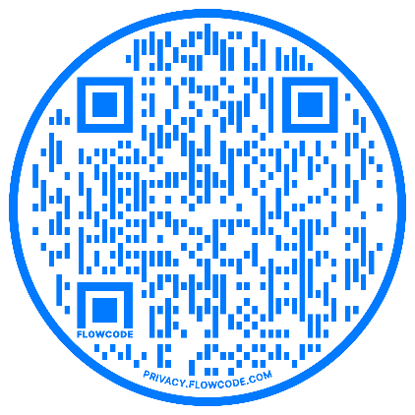
Homeownership Program Staff Contacts
Akeria S. Brown, MBA
Homeownership Program Administrator
Arlington County – Community Planning, Housing & Development (CPHD) - Housing Division
2100 Clarendon Blvd., Suite 700 Arlington, VA 22201
asbrown@arlingtonva.us | (T) 703.228.7958
Odalis Barrios
Housing Specialist
Arlington County – Community Planning, Housing &
Development (CPHD) - Housing Division
2100 Clarendon Blvd., Suite 700 Arlington, VA 22201
obarrios@arlingtonva.us | (T) 703.228.3793
https://www.arlingtonva.us/homeownership

